Slide 1
A History of George Fred Smith
Compiled by his Grandson – Brent N. Smith
Notes:
Presented July 30, 2011 Smith Family Reunion

Slide 2
George Fred Smith
28 Dec 1859 – 14 May 1942

Slide 3
George Fred Smith (1859 – 1942) – Elizabeth Ann Newman
Mary Elizabeth Taubman

Slide 4
George W. Smith (1823 – 1888) – Catherine Wooten (1828 – 1883)
George Fred Smith (1859 – 1942) – Elizabeth Ann Newman
Mary Elizabeth Taubman

Slide 5
George Smith (1793 – 1844) – Patience Timson (1792 – 1872)
George W. Smith (1823 – 1888) – Catherine Wooten (1828 – 1883)
George Fred Smith (1859 – 1942) – Elizabeth Ann Newman
Mary Elizabeth Taubman

Slide 6
George Smith (1793 – 1844) – Patience Timson (1792 – 1872)
George W. Smith (1823 – 1888) – Catherine Wooten (1828 – 1883)
George Fred Smith (1859 – 1942) – Elizabeth Ann Newman
Mary Elizabeth Taubman
Raymont Fred Smith (1896 – 1959)

Slide 7
George Smith (1793 – 1844) – Patience Timson (1792 – 1872)
George W. Smith (1823 – 1888) – Catherine Wooten (1828 – 1883)
George Fred Smith (1859 – 1942) – Elizabeth Ann Newman
Mary Elizabeth Taubman
Raymont Fred Smith (1896 – 1959)
Brent Naylor Smith (1947 -

Slide 8
George Smith (1793 – 1844) – Patience Timson (1792 – 1872)
George W. Smith (1823 – 1888) – Catherine Wooten (1828 – 1883)
George Fred Smith (1859 – 1942) – Elizabeth Ann Newman
Mary Elizabeth Taubman
Raymont Fred Smith (1896 – 1959)
Brent Naylor Smith (1947 -
Marcus Ray Smith (1970 -

Slide 9
George Smith (1793 – 1844) – Patience Timson (1792 – 1872)
George W. Smith (1823 – 1888) – Catherine Wooten (1828 – 1883)
George Fred Smith (1859 – 1942) – Elizabeth Ann Newman
Mary Elizabeth Taubman
Raymont Fred Smith (1896 – 1959)
Brent Naylor Smith (1947 -
Marcus Ray Smith (1970 -
Nathan Marcus Smith (2001 -

Slide 10
George Smith (1793 – 1844) – Patience Timson (1792 – 1872)
Eaton Bray Parish, Bedfordshire, England
Agricultural Worker – School Mistress
Members of Wesleyan Methodist Church
Did not join LDS faith and died in England

Slide 11
George W. Smith (1823 – 1888) – Catherine Wooten (1828 – 1883)
Eaton Bray Parish, Bedfordshire, England
Plaiter of straw hats
Both joined the Church 29 Oct 1848 (Catherine’s parents William Wooten and
Deborah Roe joined the Church the same day as George W.)
First of our Smith family to join the Church
Children born to George W. and Catherine in England
Sobrina 29 Apr 1847
Jane 04 Oct 1848
Maria Elizabeth 18 Sep 1852 (Died 01 Oct 1852)
Marlon Lehi 08 Mar 1854 (Died same day)

Slide 12
The Clara Wheeler 174 foot square-rigger Left Liverpool 24 Apr 1854 Arrived New Orleans 03 Jul 1854 (70 days at sea)

Slide 13
George W. Smith (1823 – 1888) – Catherine Wooten (1828 – 1883)
Left England 24 Apr 1954 on the Clara Wheeler to New Orleans
Crossed the plains in the Milo Andrus Company departing Mormon Grove, Kansas 04 Aug 1855
Arrived in the Salt Lake Valley 24 Oct 1855
Settled in Farmington with his brother Thomas X. and family
Sealed in Endowment House 27 Mar 1857
Children born in Utah
5. Annie Merintha 28 Sep 1855 (born on the plains of Wyoming)
Georgiana 21 Jan 1858
George Fred 28 Dec 1859
Ida 15 Sep 1862
Amena 20 Jan 1864
Lucy Evelyn 09 Jul 1866
Alonzo Bray 18 May 1868

Slide 14
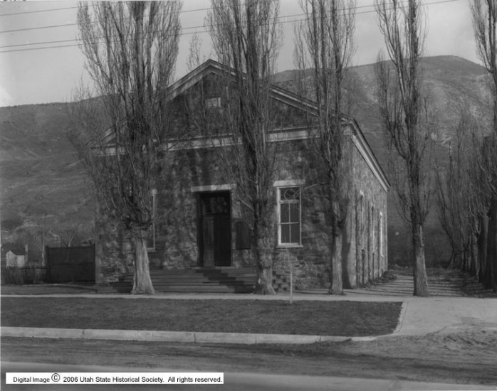
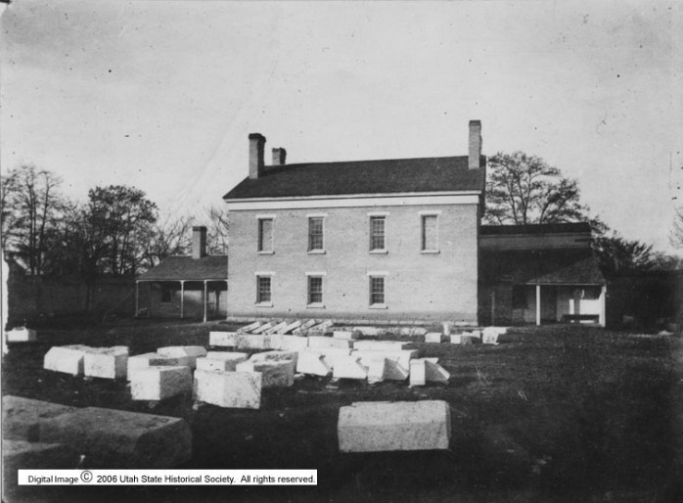
Life in Farmington 1855 - 1870
Endowment house in Salt Lake City
1855 - 1889
Stone church building in Farmington built in 1863
Smiths would have attended Church and school here

Slide 15
George Fred Smith (Youth)
Born in Farmington 28 Dec 1859
Baptized 29 Oct 1868 (age 8 years nine months)
Walked 390 miles to the “Muddy” Fall of 1870 at age 10
Walked 370 miles back to Salt Lake Valley Spring of 1873 at age 13
5 feet 4 inches tall as an adult
First formal schooling in Holliday (through his “third grade reader”)

Slide 16
Early Photograph of Holliday

Slide 17
Settling in Holliday 1873
The Family moved near 2300 East and 4600 South
10 miles from where Catherine’s family was living in Buttlerville
Children went to formal school in school house located at 2225 East and 4800 South (site of Olympus Jr. High School today)
Attended the Big Cottonwood Ward (in that school house)
Bought a 10 acre farm at 1729 East 6400 South in 1878 or 79
Build a two room house on that property of adobe brick stomped out in the front yard by George Fred (19) and Alonzo Bray (10)

Slide 18
Home in Cottonwood
The 1860 census Smiths are in Farmington and he is a “Hatter”
The 1870 census Smiths are in Farmington and he is a “Hatter”
The 1880 census shows the Smiths in there new Cottonwood home and George W. is finally called himself a “Farmer” and not a “Hatter”
Catherine died 14 Feb 1883 at age 55 ( she was only in her new home about three years)
George W. died 30 June 1888 at age 65
Alonzo Bray was unmarried at the time and likely stayed on to work the family farm.

Slide 19
Elizabeth Ann Newman
Elizabeth Ann Newman born 06 Apr 1863 in Cottonwood
Only Child of Joseph Newman and Elizabeth Paine
George Fred (21) married Elizabeth Ann Newman (18) 28 Oct 1881
George and Elizabeth moved into a small 2 room home on property given to them by Elizabeth’s grandfather, James Payne (1725 East Vine St.)
They were less than a mile from George Fred’s farm on 6400 South
George Fred eventually inherited from Elizabeth (family) 30 acres on both sides of Vine St.

Slide 20
160 acre land grant given to Isaac Ferguson in 1870

Slide 21
160 acre land grant given to Isaac Ferguson in 1870
Vine Street

Slide 22
160 acre land grant given to Isaac Ferguson in 1870
George Fred Smith Home

Slide 23
Six children were born Fred and Elizabeth Ann Newman while living in this 2 room house with a dirt floor and adobe walls.
Orson James born 20 Jul 1882
Thomas Ruben born 30 Mar 1884
Florence Elizabeth born 07 Jan 1886
Hazel born 26 Oct 1888 (died 17 Dec 1888)
Catherine Debora born 25 Oct 1889
George Earl born 24 Mar 1891
George had a large 5 room brick home build in front of the old
2 room home
A seventh child was born in the new home shortly after moving in
Nellie Ann born 10 June 1892

Slide 24
George Fred Smith Residence at the turn of the century

Slide 25
Elizabeth Ann Newman Smith was baptized 05 Jul 1894 (31)
She was ill for a long time and passed away on 01 Feb 1995 at the age of 31
Funeral held at the Big Cottonwood Ward 04 Feb 1895
Buried in the South Cottonwood Cemetery (Murray City Cemetery)

Slide 26
Elizabeth Ann Newman Smith
The Obituary for Elizabeth Ann Newman Smith ran in the Deseret News February 16, 1895 addition
The Cause of death is unknown although our histories say she died after a long illness.
She was not quite 32 years old

Slide 27
George Fred and Elizabeth Ann had taken on live-in help as her health began to fail
At age 21 Mary Elizabeth Taubman became the primary caretaker and house keeper for six children ranging in age from 2 yrs- 7 mo. (Nellie Ann) to 12 yrs – 6 mo. (Orson James)
George Fred married Elizabeth Ann Taubman 31 Jan 1896

Slide 28
Mary Elizabeth Taubman
George Fred (36) married Mary Elizabeth Taubman (22) 31 Jan 1896
Mary Elizabeth Taubman born 30 Sep 1873
Third child of Ernst Reinhold Taubman and Ane Kirstine Jensen ( a great love story)
Ane Kirstine came to Utah alone at age 17
Ernst Reinhold came to Utah disowned by parents
They married and settled in Granite on 10 ½ acre farm
Ane Kirstine became a widow at age 35

Slide 29
George Fred and Elizabeth Ann had seven children together over the next 20 years
Raymont Fred 16 Jun 1896
Alila Esther 07 May 1898
James Ernest 10 May 1900 (died 28 Jun 1900)
Glenn Taubman 02 Aug 1901
Mary Chelta 07 May 1908
Anita 23 Nov 1910
Janice Marjorie 02 Aug 1916

Slide 30
Photograph of Mary Elizabeth Taubman taken around 1890

Slide 31
Two families come together
Mary Elizabeth (23) with step-daughter Nellie Ann (5) and her first child Raymont Fred (6 m0s)

Slide 32
The children of George Fred and Mary Elizabeth

Slide 33
A great day in their lives 24 April 1898
George Fred was sealed to Elizabeth Ann Newman and their seven children.
George Fred was also sealed to Mary Elizabeth Taubman and their first child, Raymont Fred
This party of 9 would have taken a couple of horse and buggy rigs for the 30 mile round trip to the Salt Lake Temple
Elizabeth was 8 ½ months pregnant at the time

Slide 34
Typical Horse and buggy from the era

Slide 35
Downtown Salt Lake City at the turn of the century

Slide 36
Salt Lake Temple in 1897

Slide 37
George Fred’s Children attended elementary school and church in Cottonwood
All but the last three children were baptized in the summer months in the irrigation ditch running along the northern boundry of their farm
Date and age Baptized
Orson James Aug 1892 (10)
Thomas Ruben Aug 1892 (8)
Florence Elizabeth 05 Jul 1894 (8) (same day as her mother)
Hazel Died in infancy
Catherine Debora 04 Jun 1898 (8)

Slide 38
Date and age Baptized
George Earl 01 May 1899 (8)
Nellie Ann Jun 1901 (9)
Raymont Fred 02 Jul 1904 (8)
Alila Esther 01 Jun 1906 (8)
James Ernest died in infancy
Glenn Taubman 06 Nov 1909 (8) (Granite Stake)
Mary Chelta 30 Sep 1916 (8) (Granite Stake)
Anita 29 Mar 1918 (8) (Granite Stake)
Janice Marjorie Died age 2

Slide 39
Oakwood Elementary school with District 37 school house behind 1916

Slide 40
160 acre land grant given to Isaac Ferguson in 1870
District 37 School (Oakwood Elementary

Slide 41
160 acre land grant given to Isaac Ferguson in 1870
The Cottonwood Ward (Brinton Ward)

Slide 42
History of the Wards in Holliday / Cottonwood
1856 Big Cottonwood Ward meeting in Holliday in the school house
1873 Big Cottonwood Ward built a new meeting house near by
1911 Ward split into Holliday and Brinton Wards.
The new Brinton ward met in the District 37 School house
Moved into a new ward building just south of the school in 1914
1928 the building was dedicated by Heber J. Grant and the name was changed to the Cottonwood Ward

Slide 43
1931 Photograph of the Cottonwood Ward building and congregation

Slide 44
Raymont Fred and his little brother Glenn Taubman 1904 ages 8 and 4
This photograph probably showed Raymont in his baptism and confirmation suit

Slide 45
George Fred’s Mission to Great Britain
May 1905 George Fred received a letter from the First Presidency calling him on a mission to Great Britain
He was set apart by J. Golden Kimball 23 May 1905
Mary Elizabeth was 32 year old with 9 children living at home ages 3 to 24
“Don’t worry about your family; the Lord will provide”
The boys worked the farm and the girls did housework
Mary Elizabeth made and sold butter along with eggs and buttermilk to customers from 1300 to 1700 South and 500 to 600 East driving a buggy pulled by their old race horse “Nell”

Slide 46
George Fred’s Mission to Great Britain
Elizabeth’s butter won first prize at the State Fair both years George Fred was on his mission
She did not use any of the money he had set aside for her and the family to live on while he was gone.
07 Sep 1907 he returned from his mission. He brought home with him a convert woman and her young son to live with them until arrangements could be made.
The young son had Scarlett fever but recovered
Their daughter Nellie Ann (15) died of the fever 07 Dec 1907
Their daughter Mary Chelta was named after Cheltenham, England, the headquarters for George Fred’s mission

Slide 47
Fond memories of a great family Life
The Home and yard was great place to work and play
The Kitchen was a warm and friendly place
They always had the latest model stove and heater
The kids would wait Sunday afternoon for “Dad” to read them
the “Funny Papers”
There was always a Sears and Roebuck catalog “The Wish Book” available in the little house behind the big house

Slide 48
George Fred Smith Family at Home

Slide 49
George Fred Smith Family at Home
George Fred (51)

Slide 50
George Fred Smith Family at Home
Mary Elizabeth(37) and daughter Anita (10 mos.)

Slide 51
George Fred Smith Family at Home
Not pictured
Orson James (29)
Thomas Ruben (27)
George Earl (19)

Slide 52
George Fred Smith Family at Home
Catherine Debora (Gilbert) (22) and her son Morris in arms

Slide 53
George Fred Smith Family at Home
Alila Esther (13)

Slide 54
George Fred Smith Family at Home
Raymont Fred (15)

Slide 55
George Fred Smith Family at Home
Mary Chelta (03)

Slide 56
George Fred Smith Family at Home
Florence Elizabeth (Bringhurst) (25) with her son Dean in arms and daughter Naida

Slide 57
George Fred Smith Family at Home
Glenn Taubman (10)

Slide 58
George Fred Family Were prosperous Hard Working Farmers
Match pair of Percheron Work Horses
1914 Five passenger Oakland Touring Car

Slide 59
World War I and the Spanish Flu
Son Raymont Fred enlisted in the Marines but never made it to the war front because of a serious illness during training
The Spanish Flu killed an estimated 50 million people
Most public meetings were cancelled including the Church General Conference in the fall of 1918 and public funerals
George Fred, Catherine Debora and Alila Esther caught the flu but recovered
Catherine Debora’s husband of nine years (Chester Gilbert) died leaving her with 3 young boys to raise
George Fred’s youngest child, Janice Marjorie, died 05 Oct 1918 of an unrelated illness at the age of 26 months

Slide 60
Mary Elizabeth and George Fred
Photograph of Mary Elizabeth (58) and George Fred (72) taken in 1931

Slide 61
George Fred – the man
George Fred was a stalwart member of the Church throughout his life and served in many positions including missionary in Great Britain and High Councilor in the Granite Stake
George Fred served in the Community
- Instrumental in bring a culinary water system to the area
- Served as Salt Lake County Road commissioner
- Served as President of The Big Cottonwood Tanner Ditch Company
- Served as Water master for the Tanner Ditch Company
- Also served for a time as local Justice of the Peace

Slide 62
George Fred – the man
George Fred was a hard working provider for his family
- He was a successful farmer of alfalfa, beets, strawberries, apples, and chickens, cows, and horses
He bred and raised successful race horses
He composed and recited poetry
He had a great singing voice and sang in a ward quartet while he served on the High Council

Slide 63
George Fred Smith
George Fred passed away 14 May 1942
He was 82 Years old
He died at in the home he built for his
wives and children
He was surrounded by his 8 living
children when he departed this life

Slide 64
Many of George Fred’s adult children in 1954 Photograph

Slide 65
Many of George Fred’s adult children in 1954 Photograph
Mary Chelta Smith (Quick)

Slide 66
Many of George Fred’s adult children in 1954 Photograph
Alila Esther Smith (Mitchener)

Slide 67
Many of George Fred’s adult children in 1954 Photograph
Anita Smith (Vanderende)

Slide 68
Many of George Fred’s adult children in 1954 Photograph
Raymont Fred Smith

Slide 69
Many of George Fred’s adult children in 1954 Photograph
Florence Elizabeth Smith (Bringhurst)

Slide 70
Many of George Fred’s adult children in 1954 Photograph
Catherine Debora Smith (Gilbert)

Slide 71
George Fred Smith was preceded in death by six of his children
Hazel died 17 Dec 1888 at age 7 weeks
James Ernest died 28 Jun 1900 at age 6 weeks
Nellie Ann died 07 Dec 1907 at age 15 years
George Earl died 09 Dec 1912 at age 21 years
Janice Marjorie died 05 Oct 1918 at age 2 years
Thomas Ruben died 11 Nov 1937 at age 53

Slide 72
George Fred’s remaining eight children have long since passed
Raymont Fred died 03 Dec 1959 at age 63 years
Catherine Debora died 27 Mar 1971 at age 81 years
Orson James died 15 Jul 1971 at age 88 weeks
Anita died 30 Dec 1975 age 65 years
Florence Elizabeth died 09 Jan 1982 at age 96 years
Alila Esther died 05 Feb 1982 at age 83 years
Glenn Taubman died 21 Apr 1984 at age 82 years
Mary Chelta died 05 May 1989 at age 80 years

Slide 73
George Fred and his wives, Elizabeth Ann Newman and Mary Elizabeth and their fourteen Children and their spouses have long been reunited
Many of their grandchildren, great grandchildren and some great-great grandchildren have joined the family reunion on the other side.
We who are still living are grateful for the great example of faithful service and sacrifice of these wonderful ancestors

