Slide 1
1
Notes:
1

Slide 2
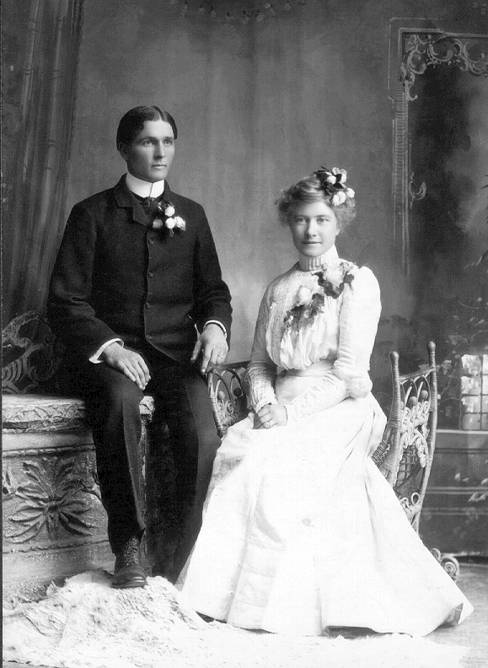
TRUE TO THE FAITH
Eugene & Mary Christiansen Smith
Report Prepared by: David Barkdull (great grandson)
Smith Family Reunion
30 July 2011

Slide 3
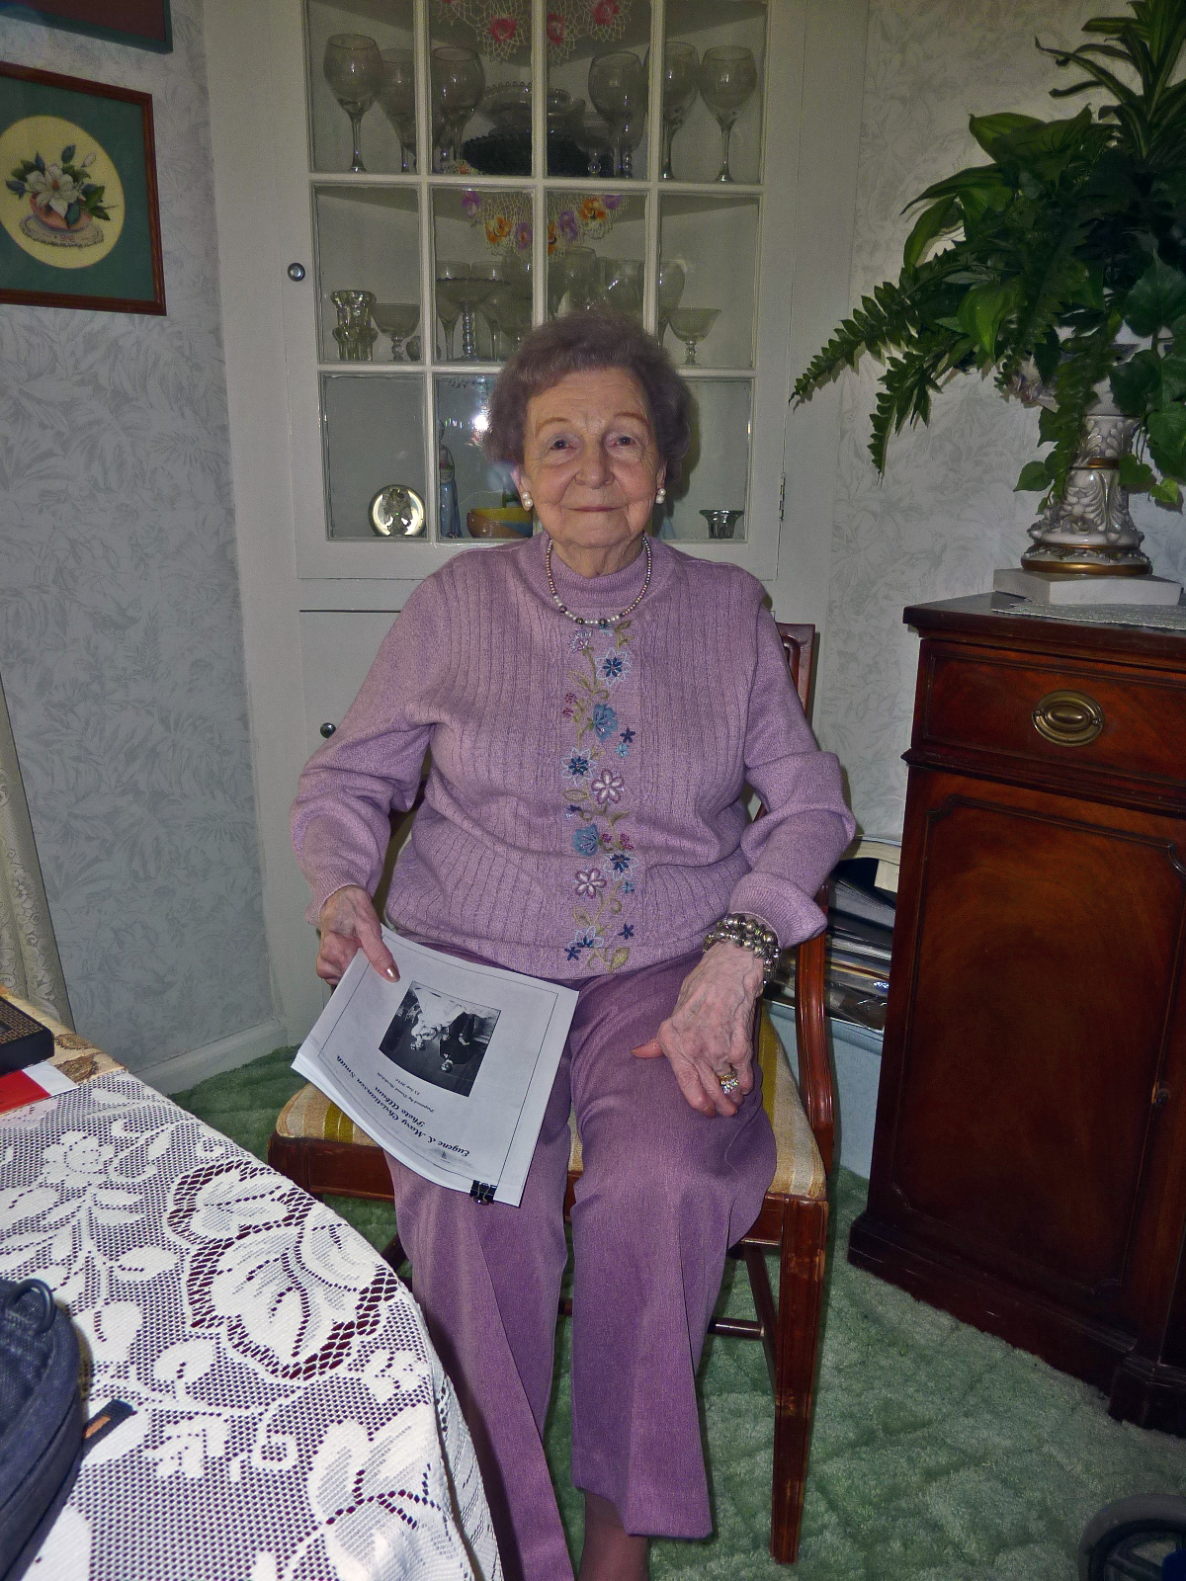
Dora Lee Anderson Thomason
1913 - 2010
Thank you!

Slide 4
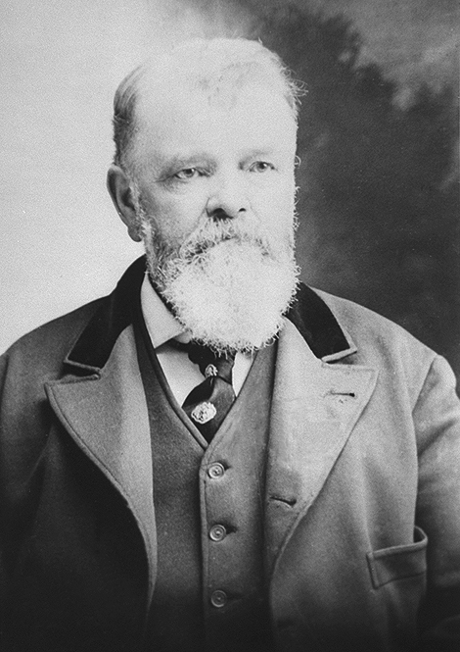
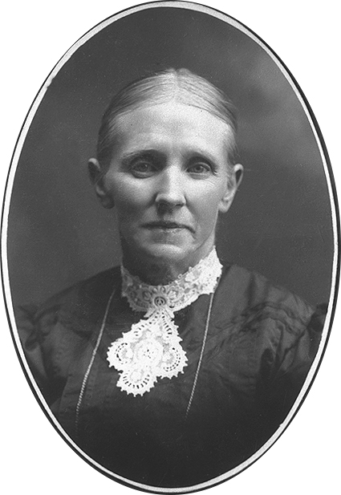
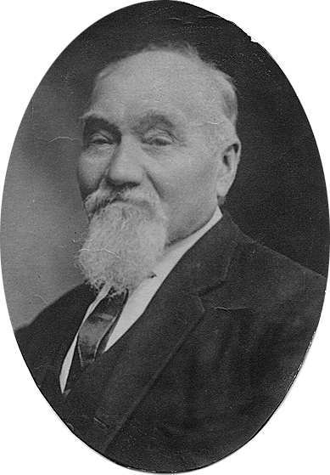
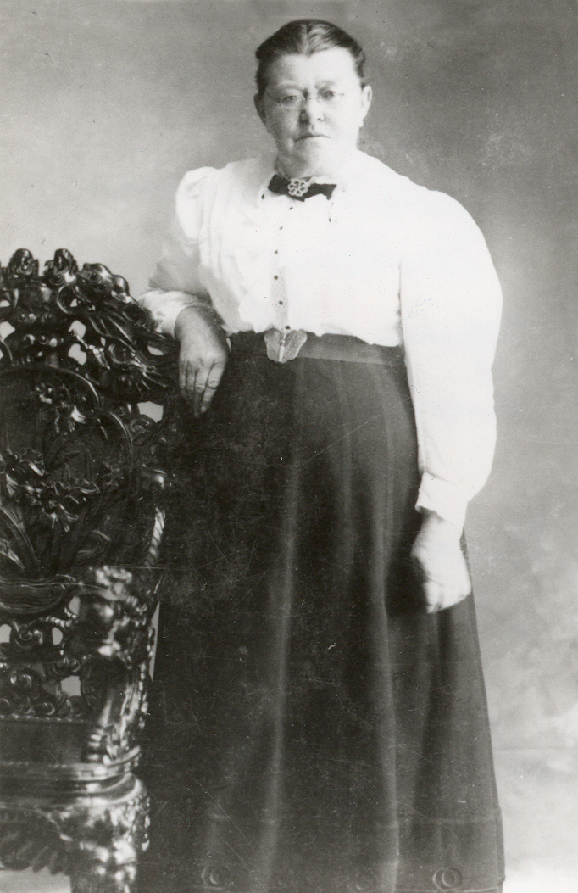
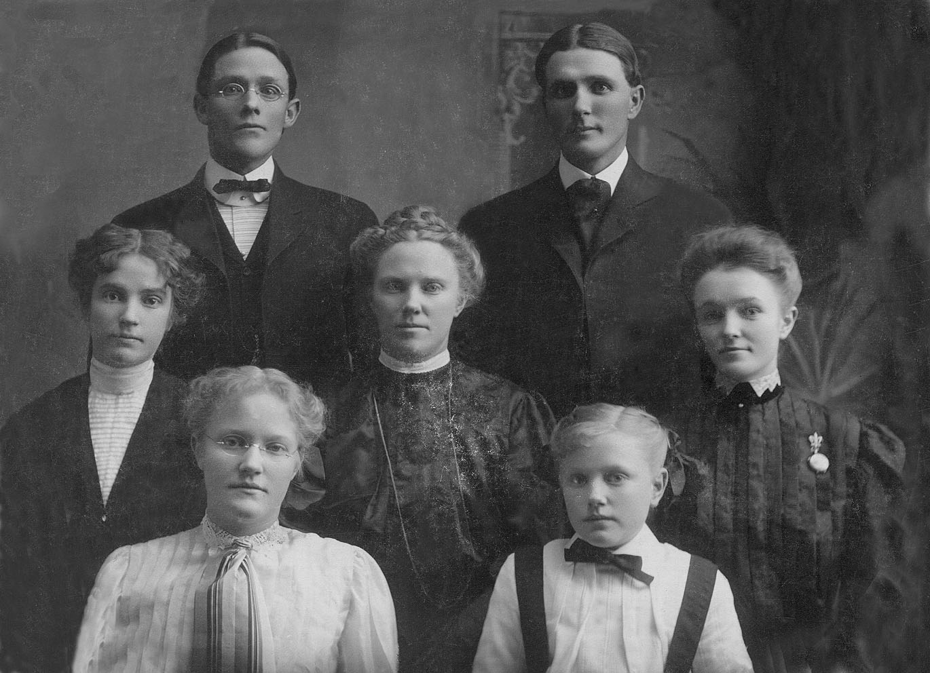
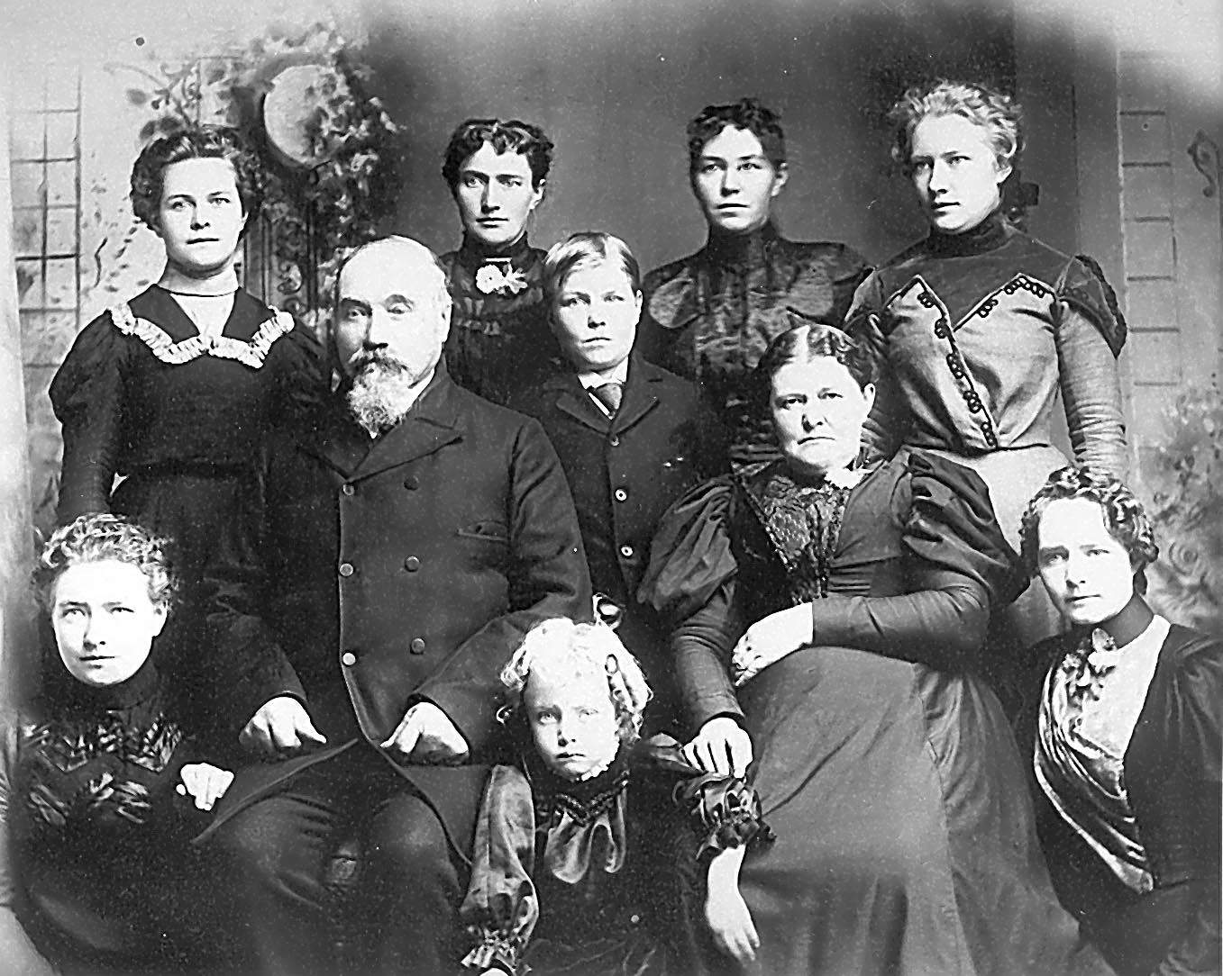
Smith an Christiansen Families
About 1900: Thomas X. & Ane Smith 2nd family
Back to front; Left to Right: David, Eugene, Mabel, Fannie, Patience, Marie, and Jennie
About 1902: Peter and Ane Maria (3rd wife) Christiansen and family.
Top, L>R: Esther, Martha, Helena, Mary
Middle: Peter, Peter Victor, Ane Maria
Front: Ane Christina, Irma, Marie
4
Notes:
4
Smith Family
Thomas converted and immigrated in 1852
Anne Howe converted when 16, family baptized by Moses Thatcher
Married TXS, settled in Logan
Eugene third to oldest of seven, David and “Fanny” oldest
Christiansen Family
Parents joined the church in 1861, immigrated in 1862, settled in Hyrum
Mary fifth of eight children, all sisters except one younger brother
First Generation converts had the fire of the Gospel and the suffered persecution for their religious beliefs and came to America, to Utah.

Slide 5
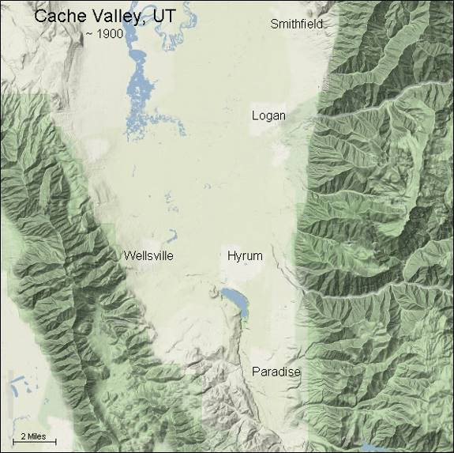
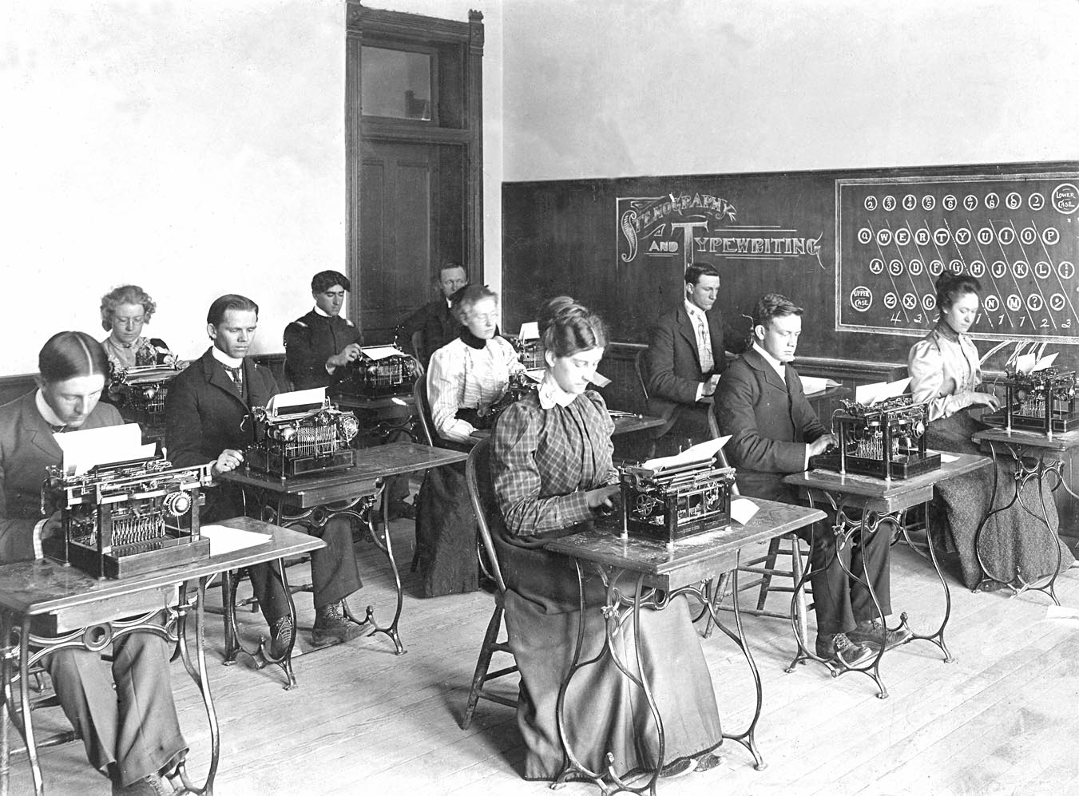
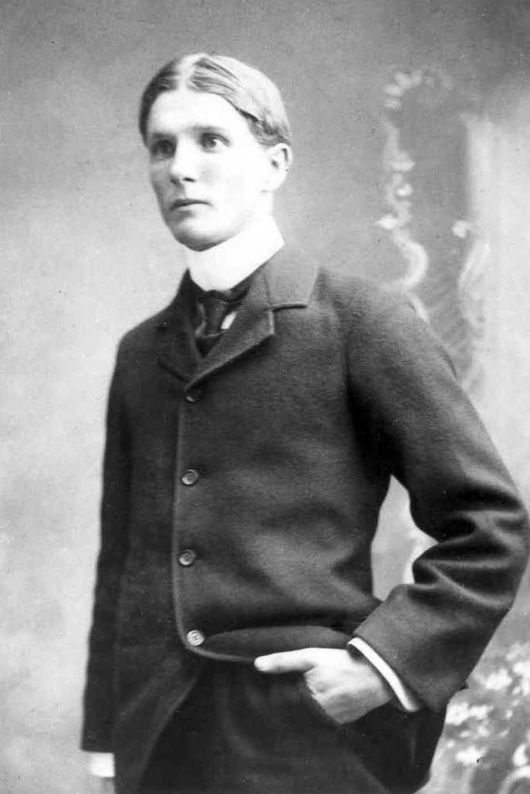
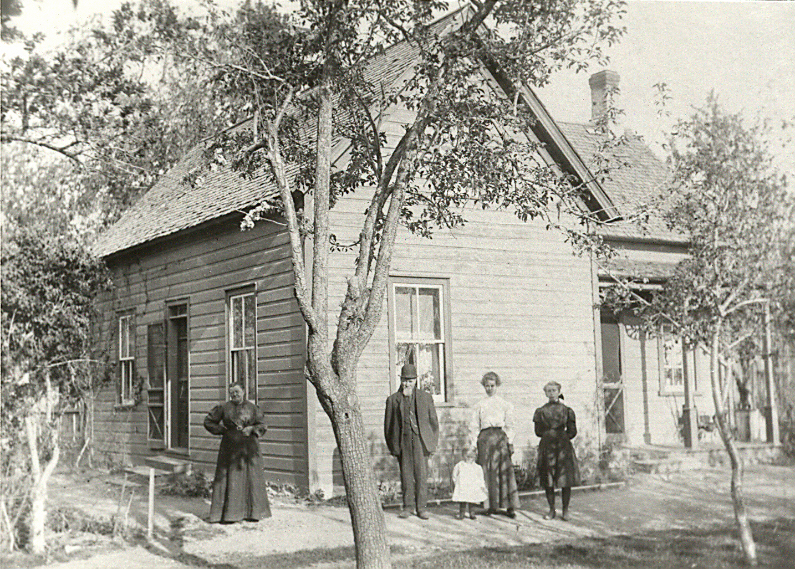
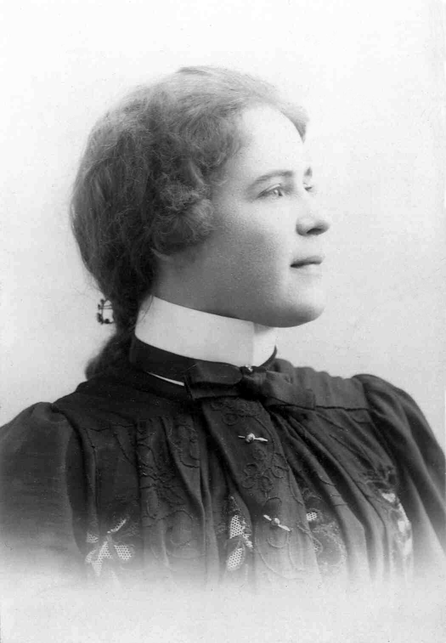
Growing Up in Cache Valley, Utah
N
5
Notes:
5
Eugene
-- 24 May 1879: born
I remember well one incident that happened in my schooling. Miss Rice had forbidden us to duck our heads in the stream of water flowing past the school. One day seven of we boys disobeyed. We were placed in a row in front of the pupils to remain until the close of school. Strictly she enjoined us not to laugh saying, "The first one that laughs, I'll whip with this ruler." Solemnly we stood there. In a little while I looked along the line at my fellow offenders. The dejected expression on the solemn face of Alfred Liljenquist, who looked like a drowned rat with his hair plastered close to his tanned face and neck and water dripping to the floor was too much for me. I could not suppress my feelings but indulged in hearty laugh.
At the close of school, I received my punishment. Whack came the ruler over my back and shoulders, then over my head. For a time I did not flinch then the punishment became so severe that it brought tears to my eyes. They must have touched Miss Rice. She desisted, closed the school, but asked me to remain. During her talk to me we both cried. From that time forth she was kinder to me and I tried in every way to please her and be a help to her.
Mary
-- 29 Mar 1882: Born
-- 1896-1900: Attended Agricultural College of Utah, Logan/Short Commercial Course
-- ~1895: Marlers one summer in Lorenzo

Slide 6
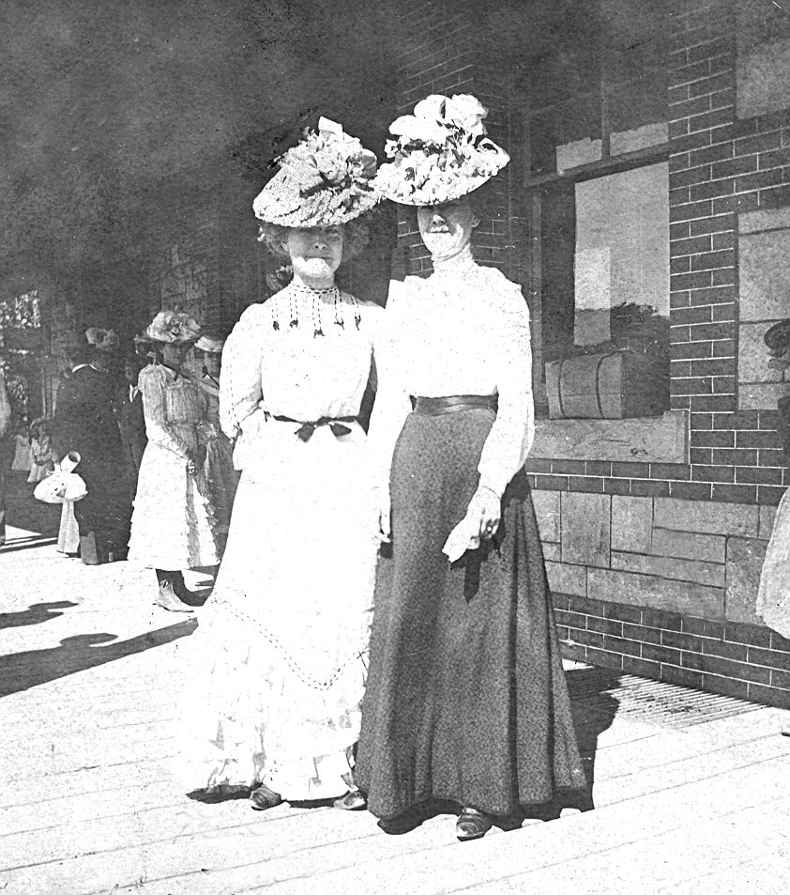
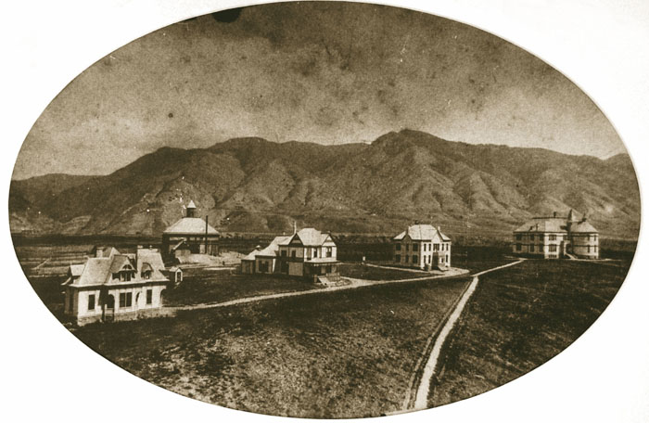
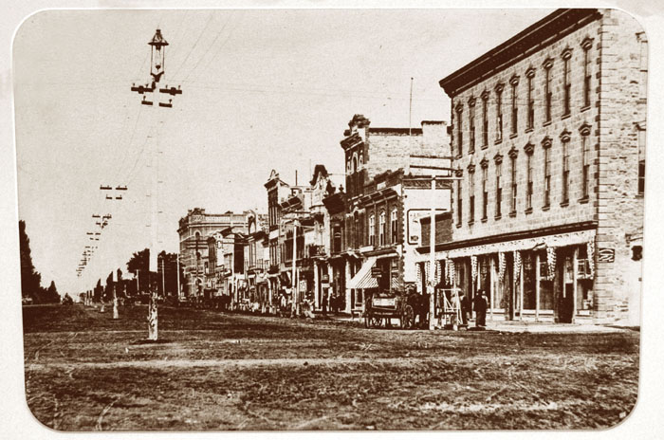
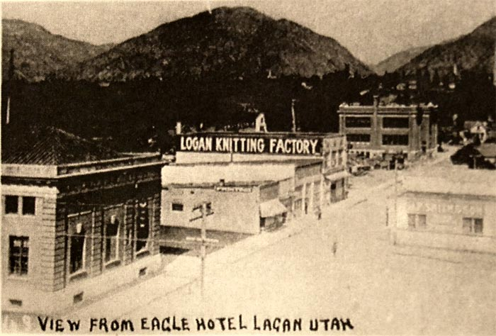
Growing Up in Cache Valley, Utah
1898: Mary Christiansen and Unidentified Friend,
Logan train station, Utah
1902: Eugene Smith, Logan, Utah
About 1892: Utah Agricultural College, Logan, Utah. Where Mary attended college
About 1895: 100 North Center Street, Logan Utah
About 1912: Logan Knitting Factory
6
Notes:
6
Eugene
-- Meticulously clean and tidy
Eugene was always proud of his personal appearances and grooming. Everything he wore had to be spotless. The custom in those days was a weekly bath. But Eugene had a daily bath even if it meant gong out to the well bringing the water up in buckets and heating it in the fireplace and later on the kitchen stove. One day he was asked to attend a picnic and he took a long time in dressing perfectly and then asked his brother and sisters if he looked alright. They assured him that he did and although he believed them, he still had to see for himself. So he went out to the well, looked down into the still water below and sure enough there was his meticulous reflection. Then all of a sudden his hat fell off into the well. After retrieving his hat from inside the well he was no longer spotless. So he took another bath and cleaned his clothes but by the time he was ready it was too late to attend the picnic.
-- Learned responsibility from taking his father's tithe's to the Store House, helped and saw how it was used.
-- Enjoyed the outdoors
Mary:
--Gold Letters, by Ellen Anderson Seedall
1899: 17 years old
Speak at Stake Conf in the Tabernacle
Prepared memorized talk
“Suddenly her confidence left her and she was struck dumb and could not remember a word of her talk. Then a calming confidence came over her and she remembered the words of the brother who had given the opening prayer. He had asked that the speakers might be able to give their talks pleasingly with respect for the Lord’s teachings.
She closed her eyes for a brief moment and offered a short silent prayer to remind the Lord that she had fasted and prayed and that a prayer had been offered in behalf of the speakers and would He please help her to say the things she had prepared.
As she opened her eyes and looked out above the audiences’ heads, she saw her entire speech written in letters of gold and she commenced speaking without further trouble. After the meeting, many complimented her on her talk and how well she had done.”
-- Stenographer: Republican Party, C.V. Mercantile, Logan Knitting Factory

Slide 7
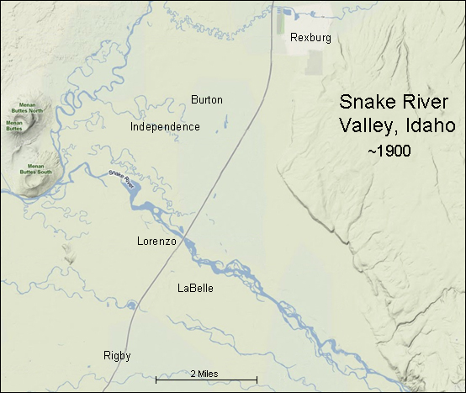
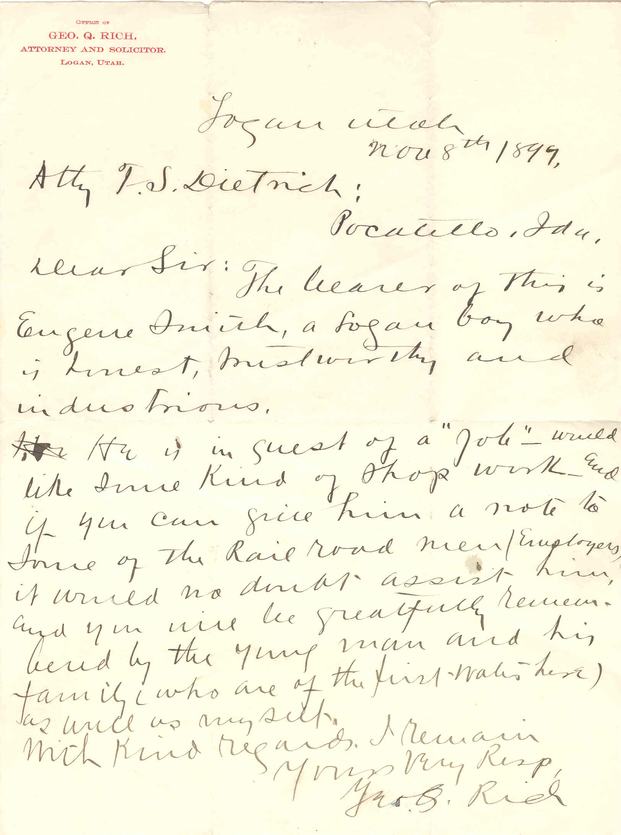
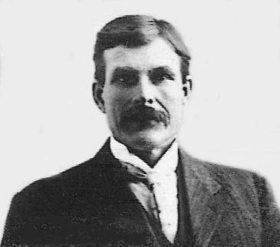
North to Idaho
N
Letter of Recommendation
"Fred" G. Smith, lived in Rexburg, Idaho.
7
Notes:
7
Character: Letter of recommendation - "The bearer of this is Eugene Smith, a Logan boy who is honest, trustworthy and industrious . . . he is in quest of a job, would like some kind of shop work and if you can give him a note to some of the railroad men/employers it would no doubt assist him and you will be gratefully remembered by the young man and his family who are of the first rate here, as well as myself.“ - Attorney George Rich
Job as a railroad bed grader, skilled horseman - $5. a day ($136.)
Friends with Joseph "Fred" Smith (father Fredric Smith, son of TXS), Melvin Ballard and Abraham
Woodruff

Slide 8
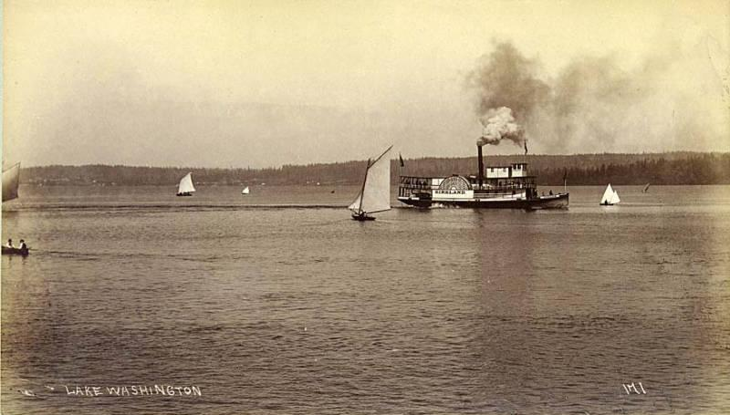
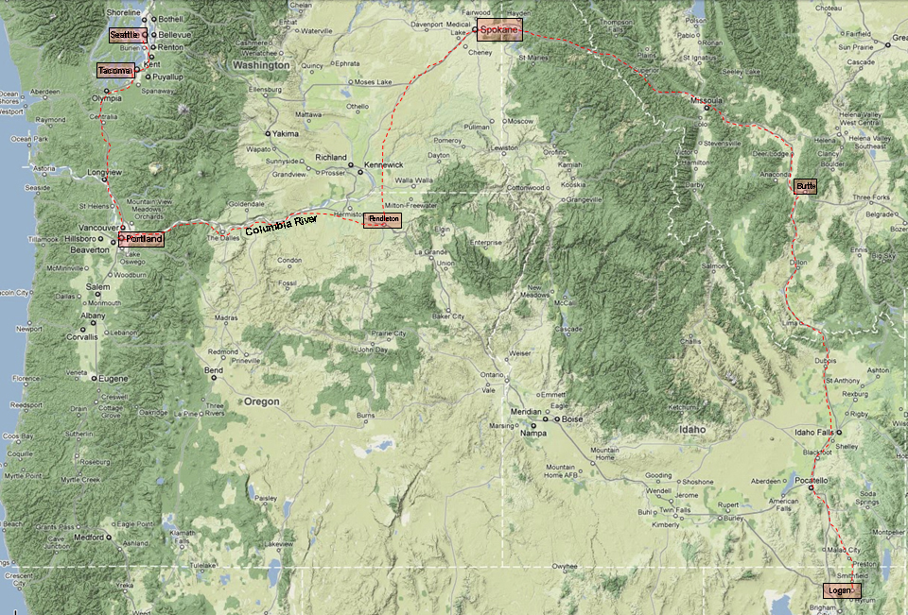
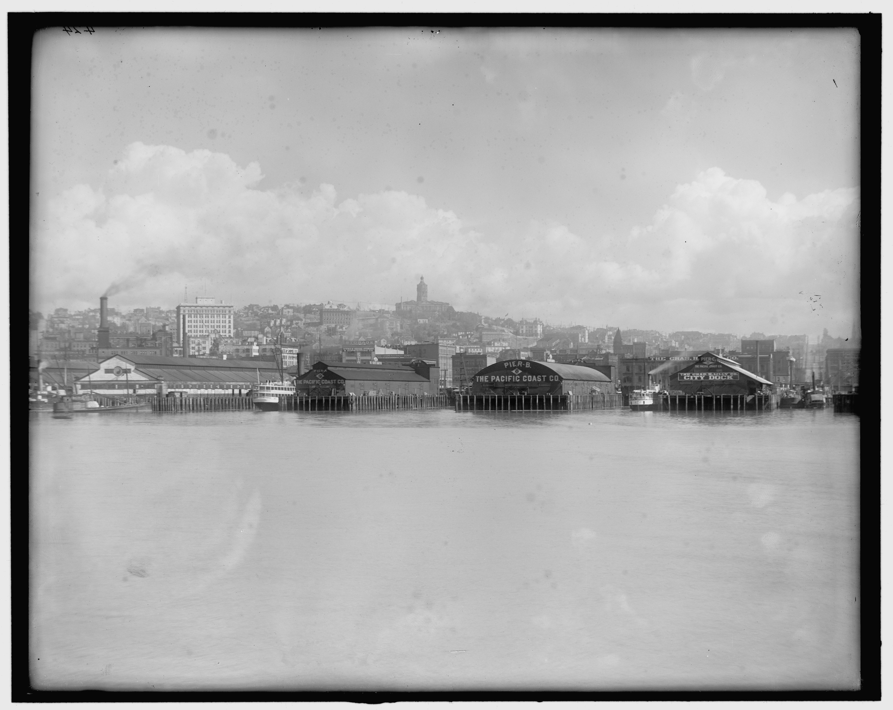
North to Alaska
1906: Steamboat on scenic Lake Washington, Seattle, Washington
1904: Puget Sound waterfront Seattle, Washington
8
Notes:
8
31 May 1901: North To Alaska Gold Fields
-- Brother Orson (48)
-- His son, Everett (~20)
-- Interest in several claims
-- Big Adventure: “I always had wished to travel and see new places. The only place I had been before were to American Fork, Utah to see my Grandma and Grandpa Howe and to Idaho. My father was a freighter and hauled goods from Salt Lake City to Butte, Montana. I had accompanied him on one trip.”
-- Logan to Butte, MT horse or Wagon
-- Butte to Seattle by train
“Our trip to Seattle was without any unusual incident with the exception of crossing the Columbia River at Portland, Oregon. I had never before crossed a ferry and was much excited when looking out of the window I could see no land only swirling waters on every side of us. Apparently we were floating on the water. How could we keep afloat? My brother explained that the train was on a large ferry boat and that as soon as we reached the Washington side we would connect with tracks and go on to our destination. In a short time we were again on rails in the ground going through Tacoma, Washington. Tacoma is built in a beautiful forest of stately pine trees.”
-- Seattle to Nome by steam ship
“At Seattle we staid at the Renes Grand hotel. This was another new experience to me. While sitting out side the hotel the next morning I was surprised to hear my name spoken. I looked up and before me was Walt Reese, a home town man who was, I learned, a gambler in Seattle. The following day, I went up to beautiful Lake Washington one of the beauty spots in a most beautiful mountainous country covered with woods. In the seven miles between the lake and Seattle, we passed only an occasional dwelling house. I wished I had money to invest in lots along that were then selling for between five and six dollars. Now the city has extended over all of the country and the land is almost priceless."

Slide 9
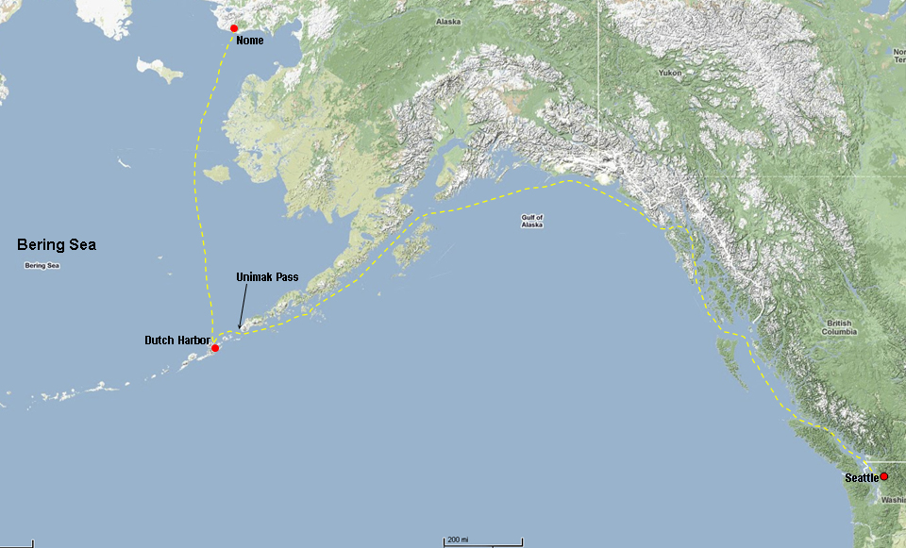
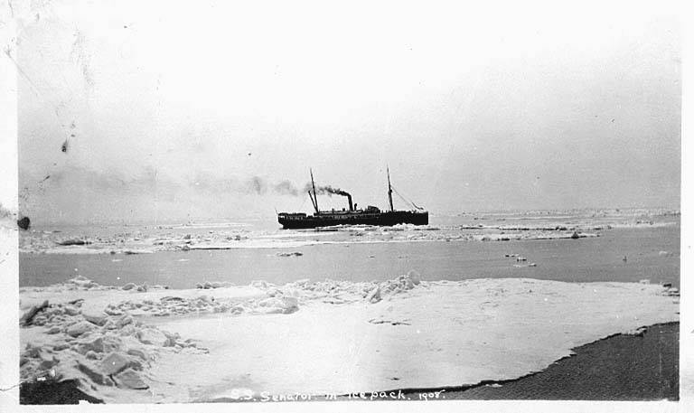
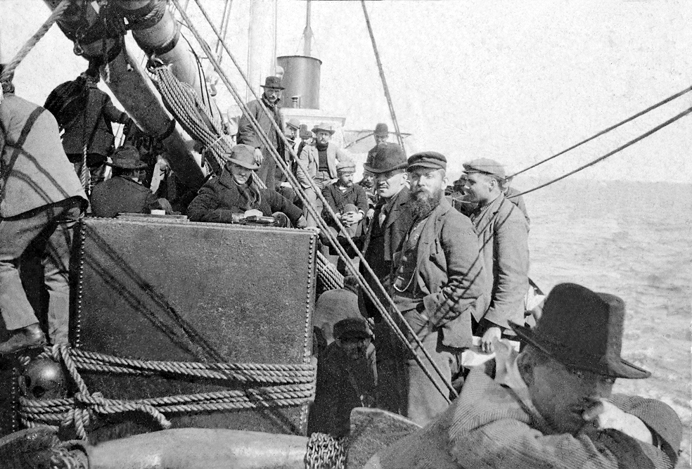
North to Alaska
About 1908: Steamship "Senator" sailing in the Ice Pack
1901: Steamship "Senator" Eugene Smith traveled to Alaska
9
Notes:
9
"We remained in Seattle five days. Five glorious days filled with sightseeing in the town which at that time had approximately five thousand people. On the third day we went down to the steamship company docks and secured passage on the "Senator". On the following night we first saw the Senator - at anchor on the docks.
The thought came to me "are we going to risk our lives on this frail vessel to travel 7,000 or miles on the ocean to our destination. We entered the ship and sailed up the Puget Sound and out into the vast ocean. When morning came the land had disappeared. All we could see was waves rolling mountain high. I got a little sea sick the first day out but then went to the middle of the boat and stayed until I got used to the motion of the ship on the water."
We sailed through Unimak Pass through the Aleutian islands chain and then to Dutch Harbor into the Bering Sea. They had to wait at Dutch Harbor because of ice in the Bering Sea. About 400 people had stopped there who were also hurrying to the gold fields with every known device to work the fields. The ice finally cleared and we were able to continue on our way north until we docked outside of the boom town of Nome, Alaska.”

Slide 10
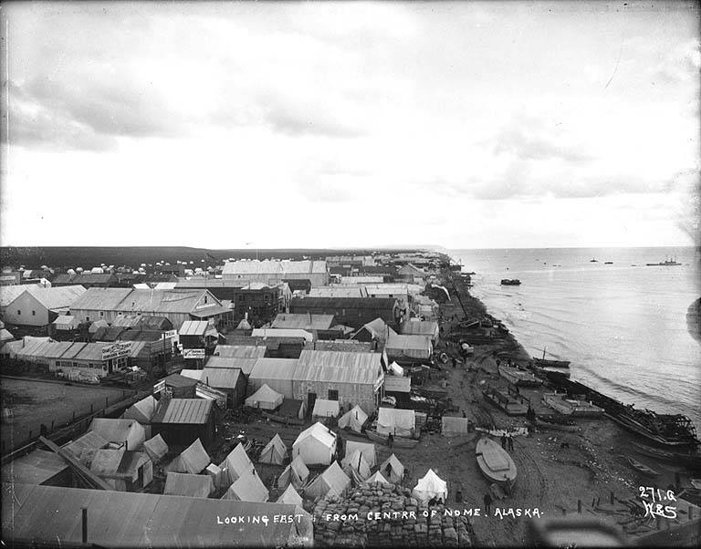
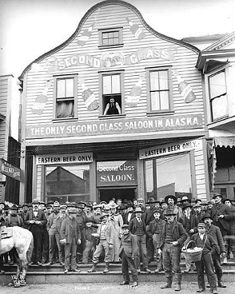
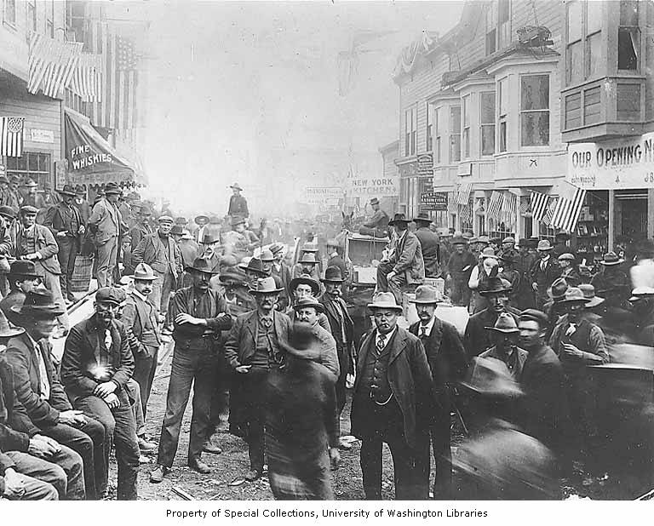
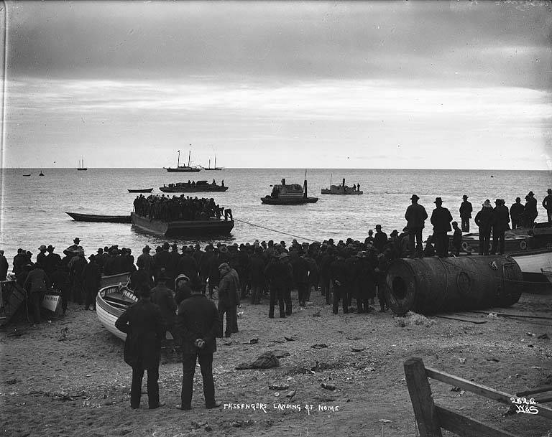
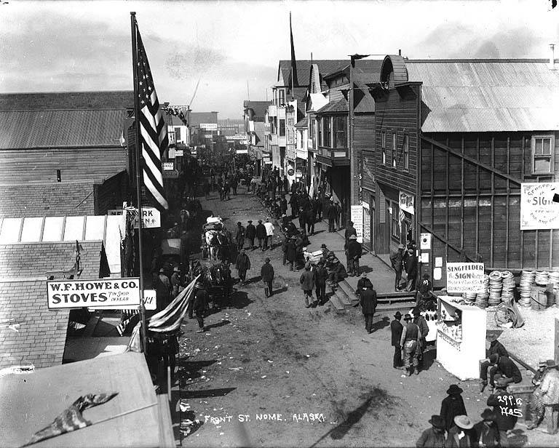
North to Alaska
The Gold Fields of Nome
1900: Water front mining camps; Nome, Alaska
1 July 1901 Bawdy Town Saloons, Nome, Alaska
4 July 1900: Cat Houses, Saloons, Gambling, Bawdy-Town ; Nome, Alaska
1900: Ship passengers landing at Nome, Alaska
1900: Front Street, Nome Alaska
10
Notes:
10
Eugene: “The ship was unloaded with litters dragging through the sea to the beach. He said that the town was "raw" and every known device of gambling was there and many men lost their fortunes in a few minutes. A gun was pulled at the least excuse and killing was common. The dance hall girls and the red light districts flourished. Food was expensive. In later years Eugene told his daughter Glenice, that all the wickedness he saw was almost more than he could stand.
At the height of the Nome gold rush, hundreds of tents extended for 15 miles along the beach to the west of town. When Elizabeth Robins, a British newspapers correspondent arrived she described the scene on the beach:
The space remaining is already piled with freight--food supplies barrels of beer and whiskey, bags of beans and flour higher than my head, lumber, acres of it, extending beyond the tents and up on the tundra, furniture, bedding, pots and pans, engines and boilers, Klondike Thawers, centrifugal pumps, pipe and hose-fittings, gold rockers, sides of bacon, blankets, smart portmanteaux and ancient sea chests--as odd a conglomeration as ever an eye rested on.
1900, Prospector Wilford McDonald: “Nome's population had exploded from a few hundred to over twenty thousand in a year, making it the largest and most lawless town in Alaska. Gangs operated freely in the crowded streets -- men sometimes hauled away cabins at night with their owners still in them. Rowdy saloons proliferated along Front Street; in 1900, Nome had fifty saloons, a number that soon doubled. Wilfred wrote: " We are away from town and glad of it. Don't want to go there. It's full of bums and sure thing men. Lots of men are getting in bad circumstances here. I think the government will have to take them out."

Slide 11
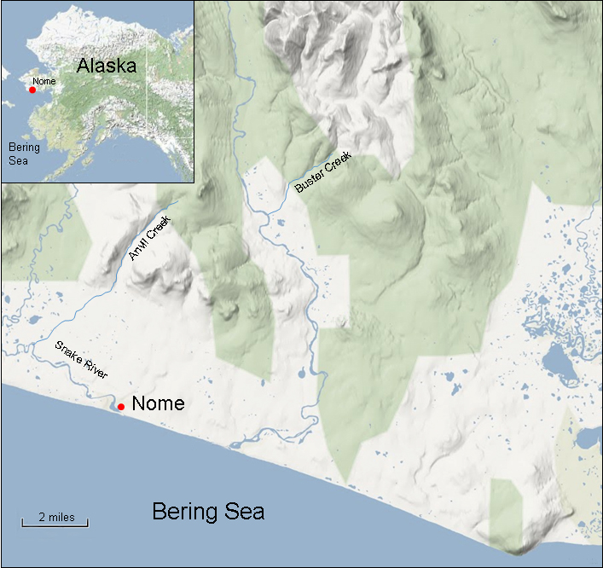
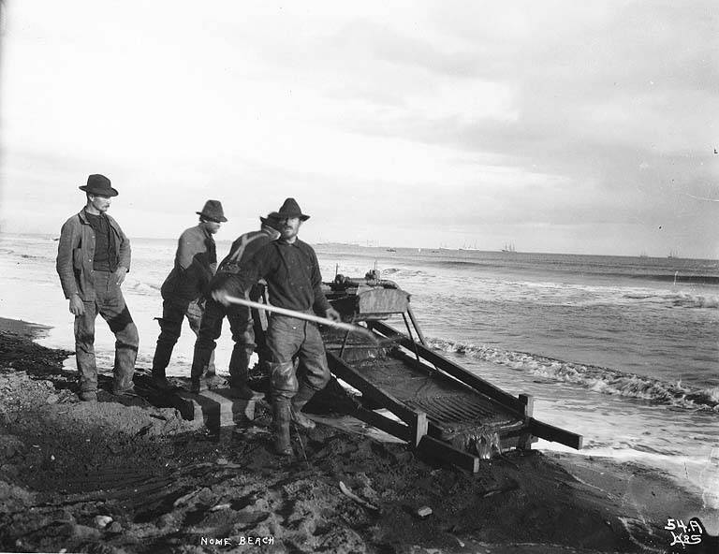
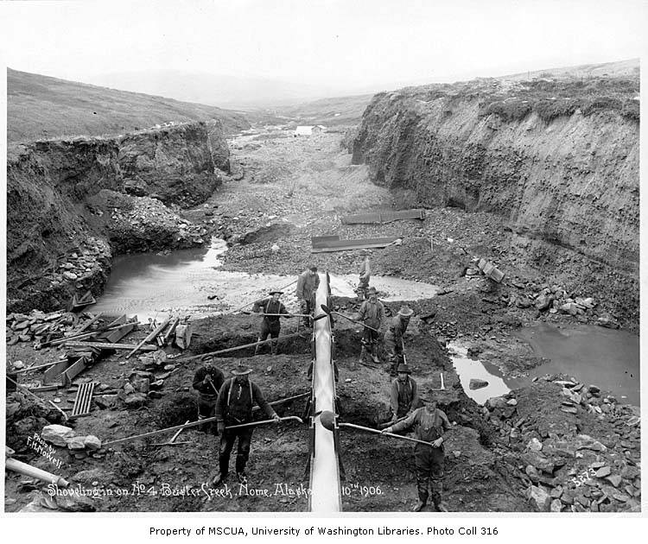
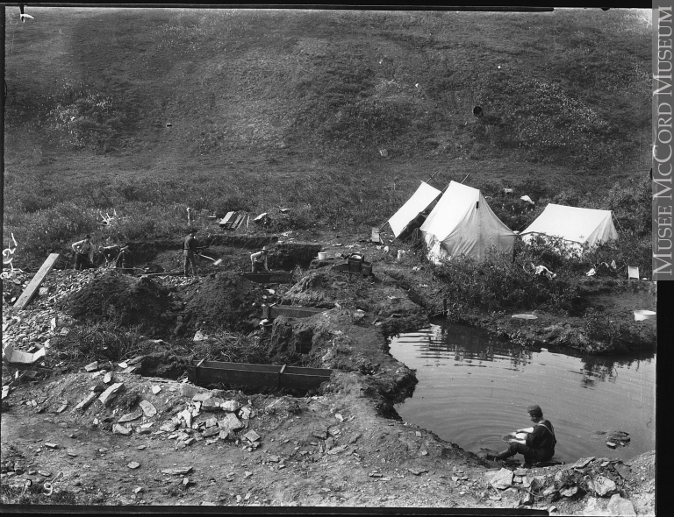
North to Alaska
The Gold Fields of Nome
N
1900: Miners using a Rocker to search for gold; Nome, Alaska
1900: Miners searching for gold, Buster
Creek; Nome, Alaska
1900: Mining for gold, Buster Creek, Alaska
11
Notes:
11
Orson, Everett, and Eugene worked on beach claims, then went to Buster Creek and worked claims there.
He also said the scenery of the country was beautiful. He said he always wanted to go back after the "Rush" was over and things had calmed down."
"We returned to Seattle by the inland passage (fall 1901). Men died on the boat and they were wrapped in a canvas, a few words were said over them and then pushed over the side of the ship into the cold ocean below. On his way home he carried his gold in a money belt around his waist. One night someone took his belt off while he was sleeping and stole all he had. He came home broke.
CONCLUSION: It was a good experience but never again did he want to be associated with people of that caliber. He developed strong protective feelings towards his family and he always tried to shield them away from those who were not living as they should.

Slide 12
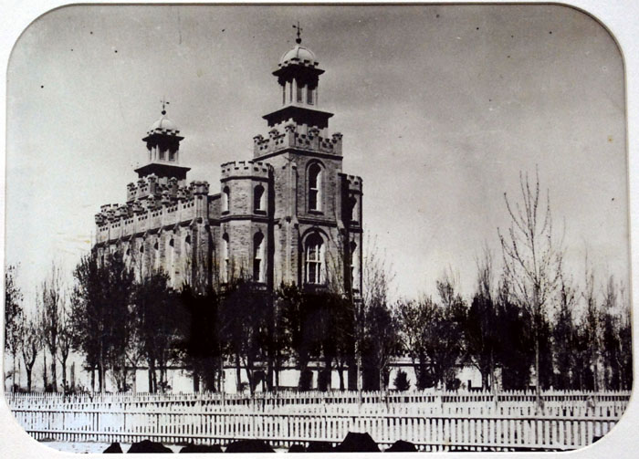
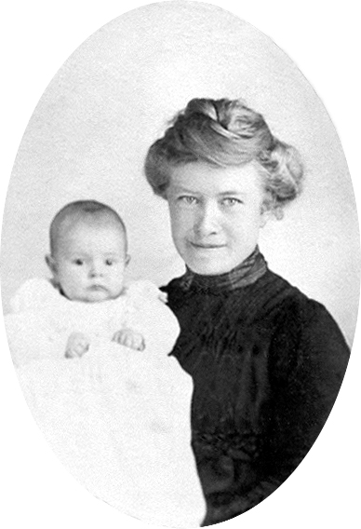
A Prayer in our Hearts & a Song on our Lips
N
1900: Logan Temple, Utah
Eugene & Mary Christiansen Smith were married here on 15 January 1902
11
Notes:
12
Eugene and Mary were courting in the fall of 1901
One letter exists, which Mary wrote: “ . . . stay in Hyrum and let Mamma doctor it . . . Mr Larson took an unusually long time to get there (Logan), because he had to stop and admire each of the very numerous large stores, factories, and ware houses that are situated in the town. Even after we got out of town he stopped the horses and took one farewell look at the beautiful sleeping village (Hyrum). He explained his enthusiasm to Norman by telling him that he did it all to divert my mind and to give me time to get over parting with you. He did it as a joke and did not realize how much he helped me."
She signed it: "Your true friend, Mary Christiansen". "P.S. remember to write ever chance you get and tell me where to address you and if you wish to hear from me, I will write you . . ."
- Married 15 Jan 1903, Logan Temple, Reception in Hyrum hosted by her parents (dinner and dance). Thomas X. gave them a cow, team of horses and some chickens
- Spring 1903: Eugene went to the Snake River Valley to look for a place
-- George and Martha Marlers already live in Lorenzo
-- Mary had spent a summer (~1896) previous helping her sister Martha
-- Returned to Hyrum in the fall, Mary pregnant
- Spring 1904: Eugene goes back to look for a place
-- Galbraith land, no home
-- Probably homestead like Marlers, live near them
-- Confusion about whether they live in LaBelle or Lorenzo (Glenice's writings)
-- In Lorenzo ward (church records confirm)

Slide 13
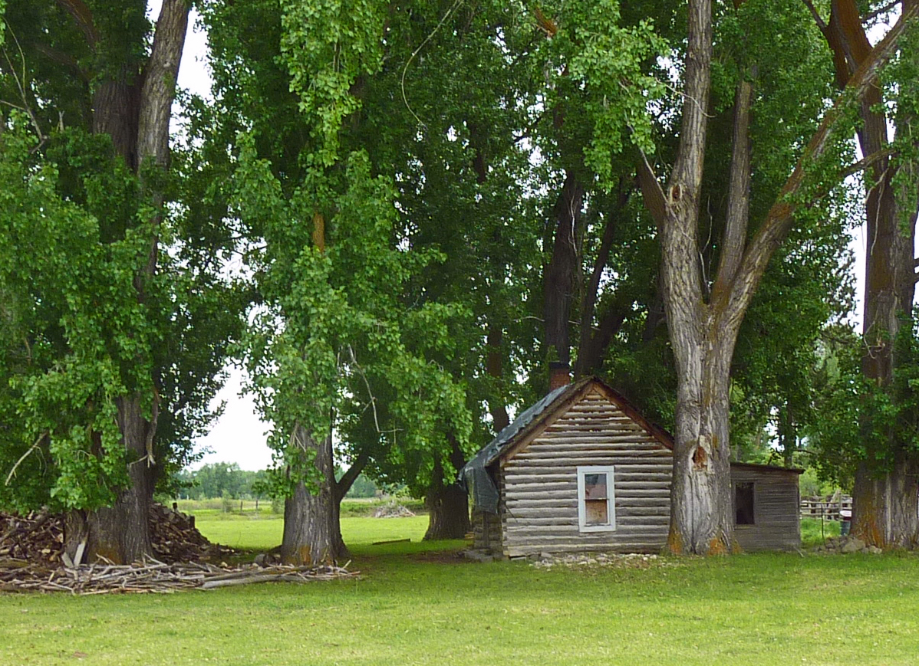
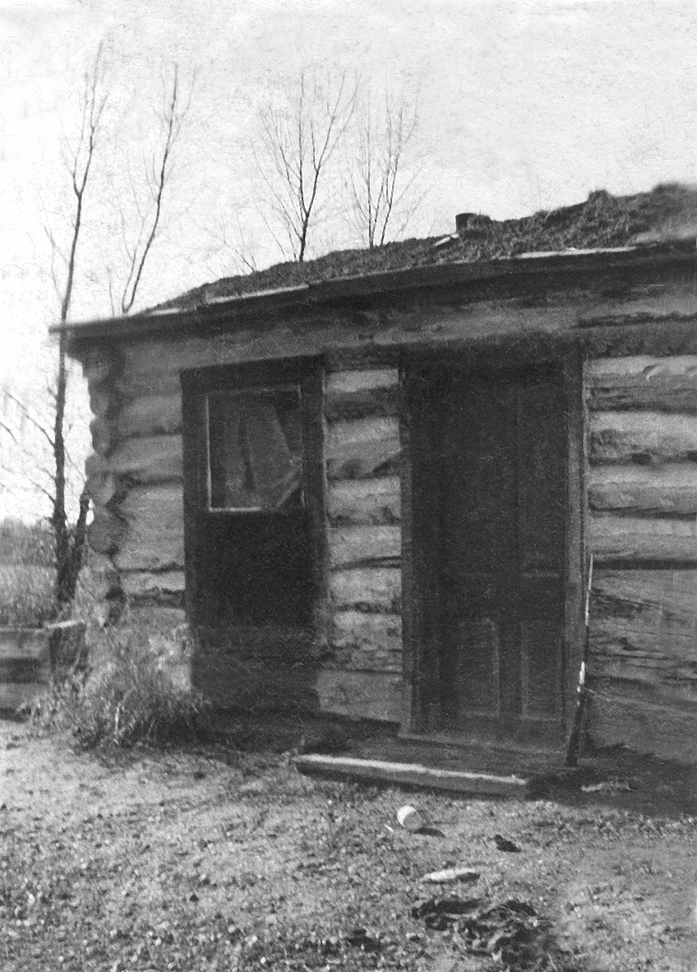
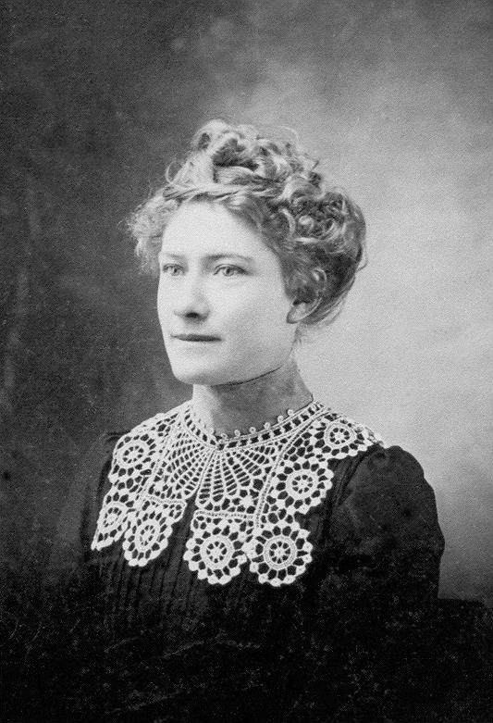

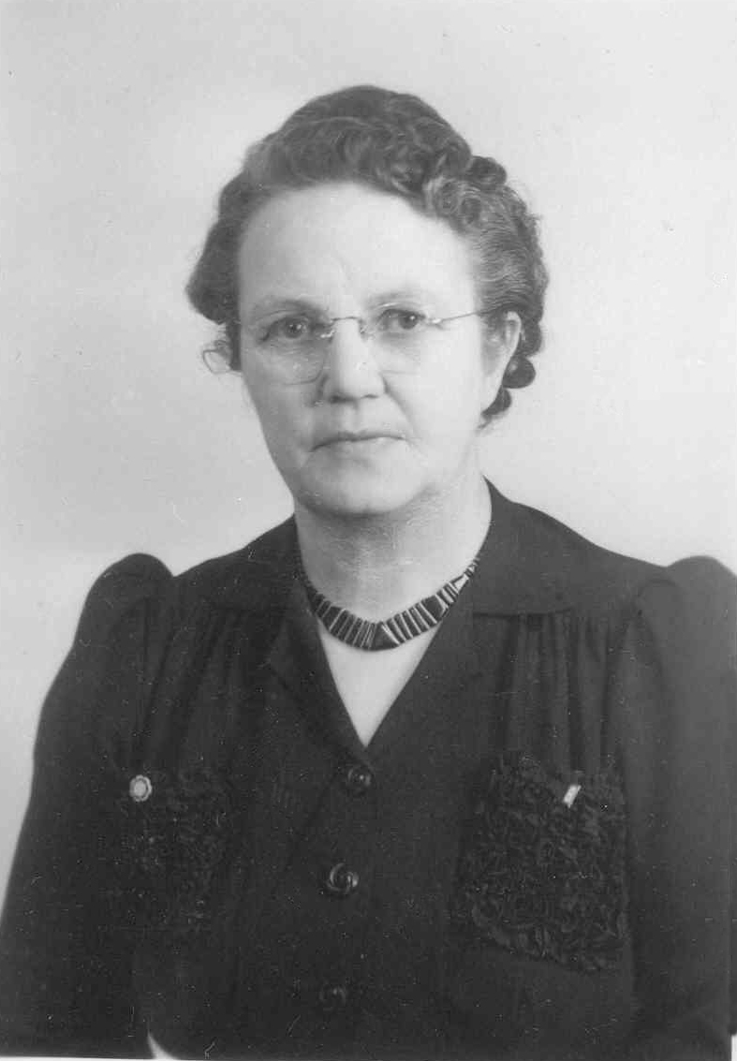

Idaho Homesteaders
1903: Lorenzo & LaBelle
Fall 1904/05: Eugene & Mary Smith's homestead
cabin. Notice the rifle next to the door; Lorenzo, ID
HOMESTEAD ACT OF 1862
2011: An old cabin about 1 mile west of Lorenzo, ID
1904: Mary C. Smith
~1950: Susie Hulse
13
Notes:
13
-- Homestead Act of 1862, Qualifications
--- Live on land 5 years
--- Build a Structure (12 x 14) and grow crops
--- File for patent
- Confusion about where live Lorenzo vs LaBelle
Glenice reports LaBelle
Records say Lorenzo
Probably homesteaded like the Marlers
- Mary takes a teaching job at LaBelle school, previous teacher took gun to school to protect self
-- Hire Susie Hulse to watch Leon
Eugene sold Watkins products . . . Natural born salesman . . . He is loved everywhere
Eugene is "Loved Everywhere"
Feb 1916
Family Friend: “Yes it is good to know people like you. You were liked here too. Br Nelson said the other day, ‘Br Smith will get along all right because he is always loved everywhere. We were always pleased when he came selling goods and that was long before we knew him as a neighbor.’"
- Pregnant in 1906
-- Kenneth born, dies six months later,
-- gossiping, “Mary shouldn’t have been working, wouldn’t have
happened if she’d been at home”

Slide 14
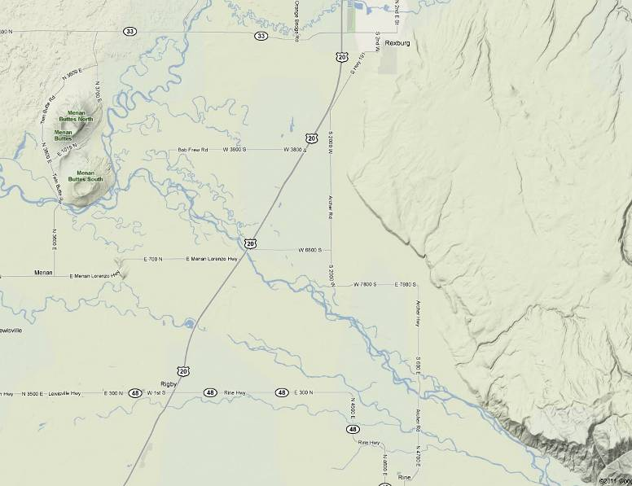

LORENZO HOMESTEAD
1903-1907
Smith’s Log Cabin
Lorenzo
LaBelle

Slide 15
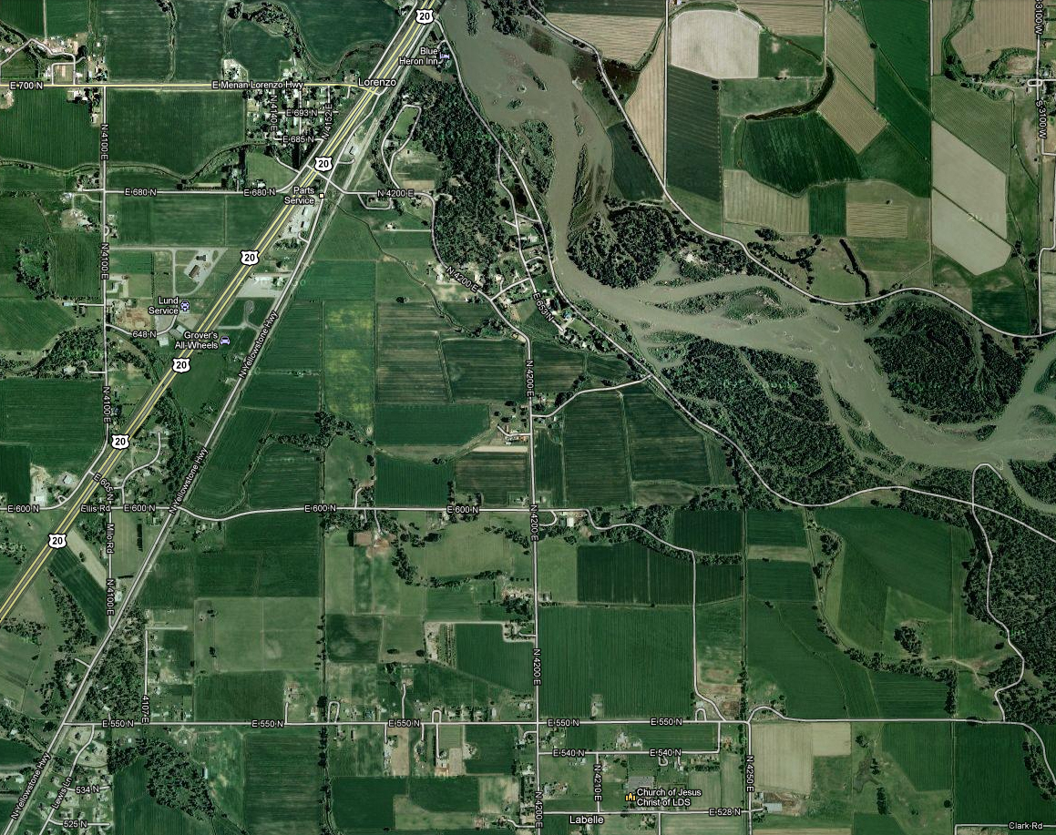
LORENZO HOMESTEAD
1903-1907
Lorenzo
Eugene Smith’s twenty-two and one half acre farm which he purchased from William Galbraith, 1 June 1903 for $600.
N
Snake River
LaBelle

Slide 16
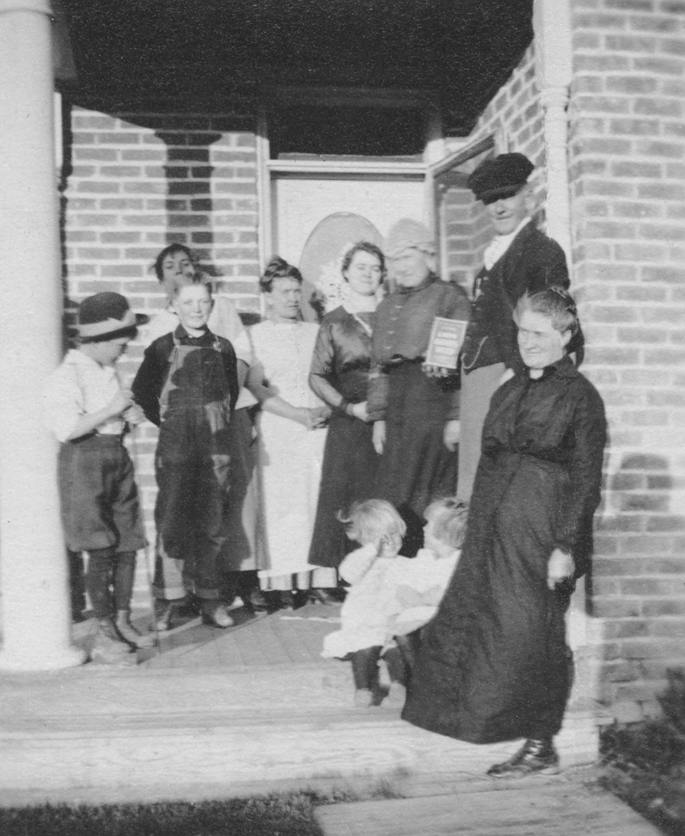
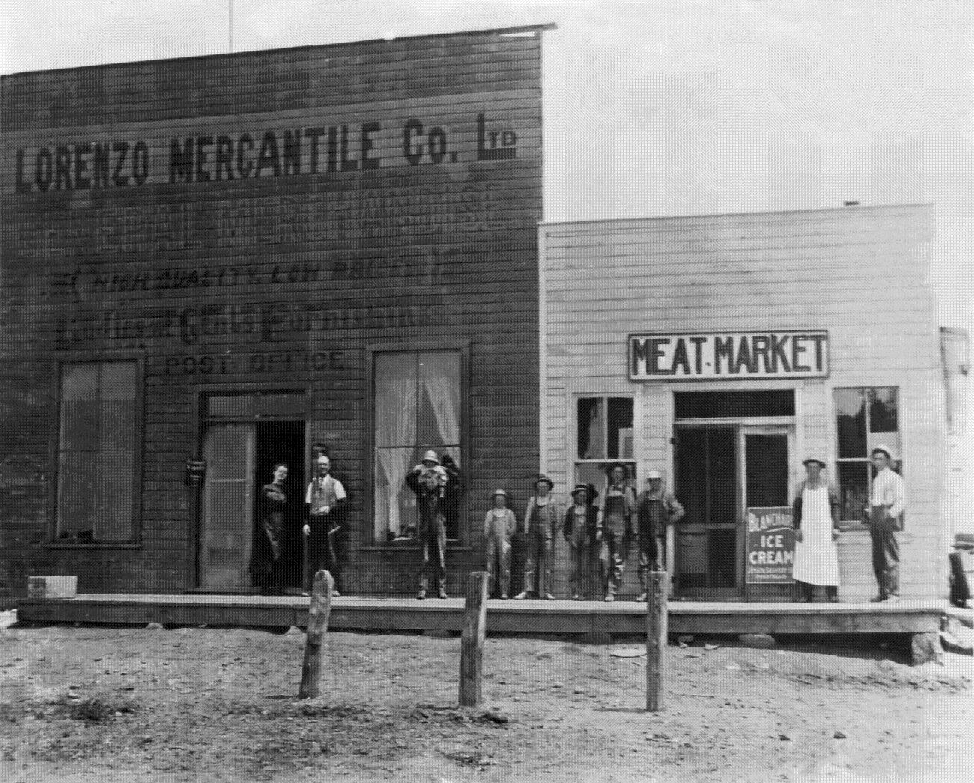
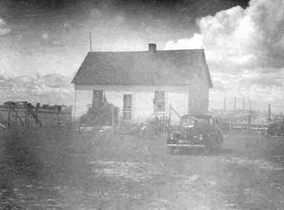
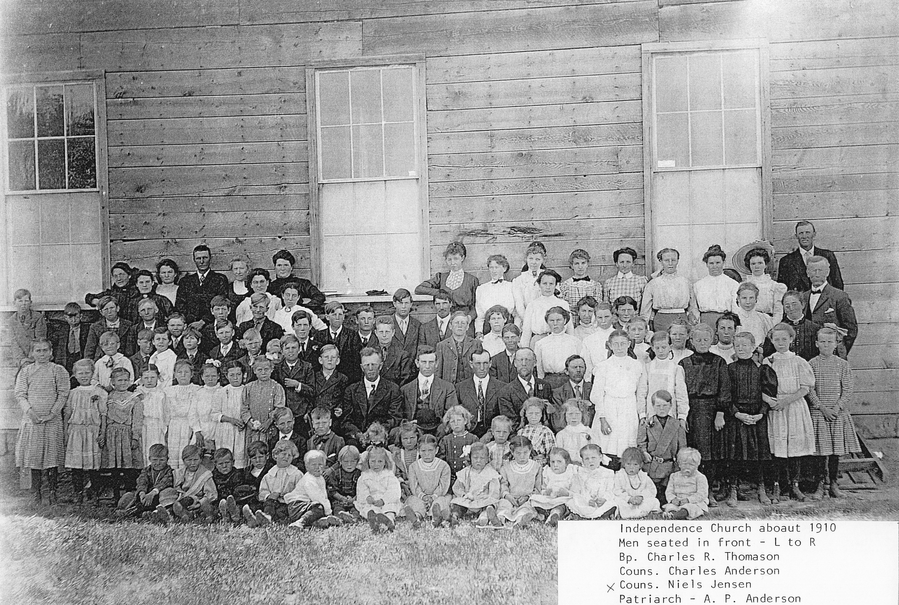
Idaho Homesteaders
1907: Independence
Smith’s and the Marlers
~1915: Lorenzo (Marler) Mercantile; Lila and George Marler (left)
Unidentified children; Geore and Emile Browning (far right); Thornton, ID
Smith's two room board house called the "Independence Home"
~1910: Back, 3rd & 4th from left Eugene & Mary Smith, Independence Ward Independence, ID
16
Notes:
16
-1907: Move to Independence
-- Lorenzo Ward records state Kenneth was born 8 Aug 1906, Lorenzo,
Fremont Co, ID.
-- But in January 1907, little six month old Kenneth became ill. His throat got
infected, swollen, and sore. Doctor Osborn was called and he gave them
medicine for Kenneth but neither did this or any of their home remedies work.
Kenneth's condition only got worse and soon he could no longer get any food
down and he finally died. All were hearth broken.
18 March 1907: Fred Klingler sold 2 room board home in Independence and ~50 acres of farmland to
Eugene Smith for $2,400.
- “Independence Home”
Marlers move to Thornton and take over Lorenzo Merc.
Who were the Marlers?
Mary’s oldest sister, Martha
Lived near each other for entire adult life (Lorenzo and Thornton)

Slide 17
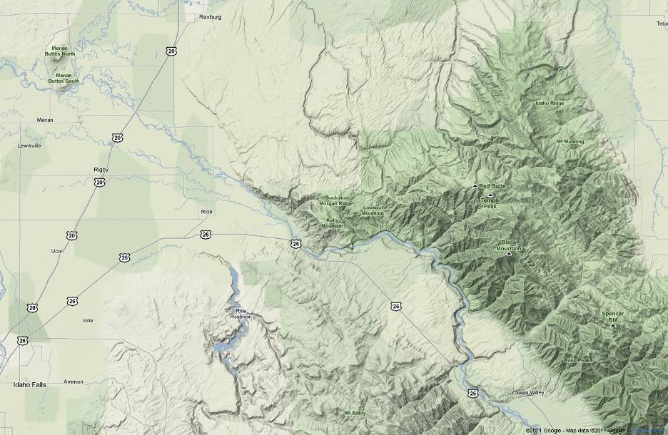
Idaho Homesteaders
Burton
Madison County
Independence
Thornton
N
Lorenzo
LaBelle
Jefferson County
Dry Farming Area
Melba
Antelope Flats
Bonneville County
17
Notes:
17
1907: Moved to Independence
Marlers moved to Thornton to take over Lorenzo Merc.

Slide 18
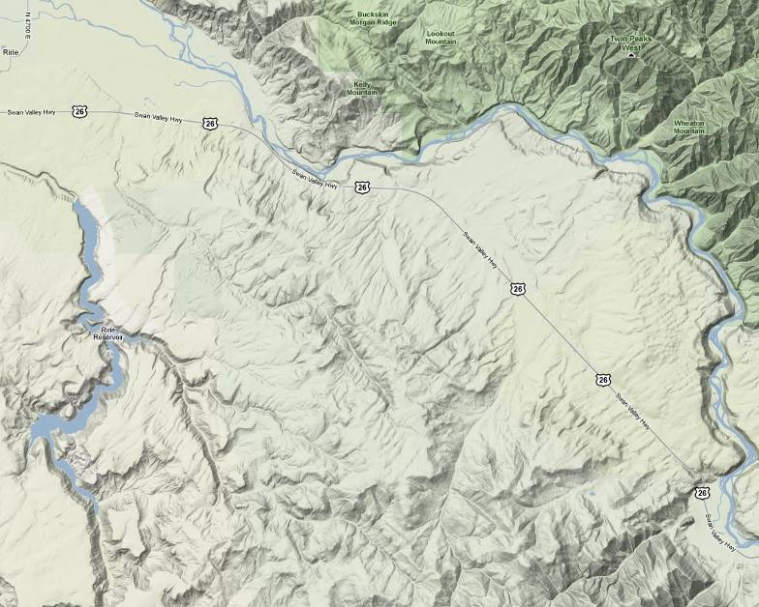
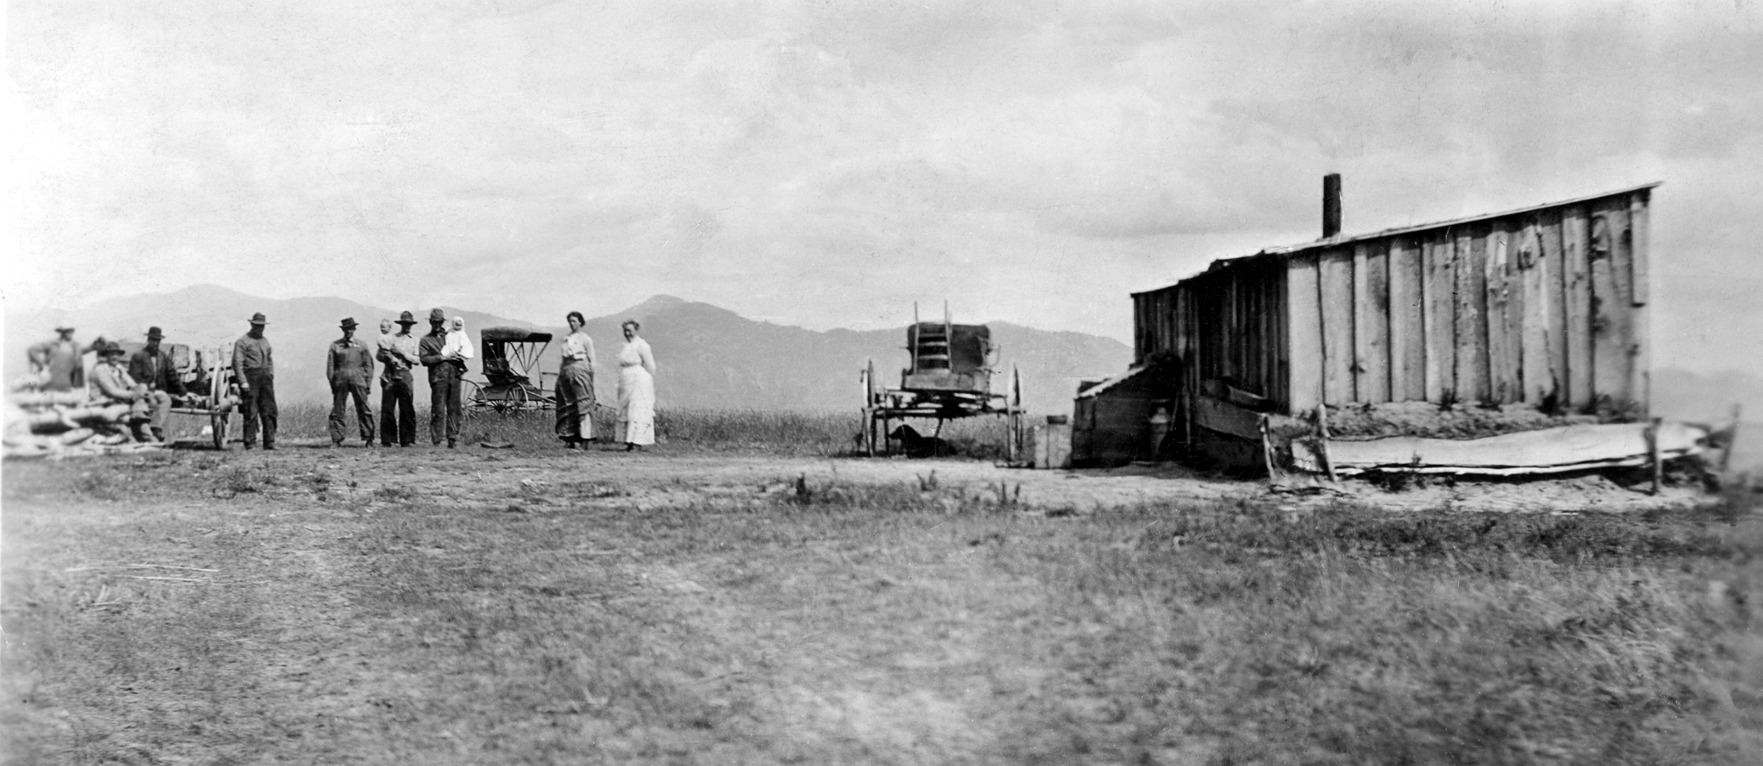
Antelope Flats Dry Farms
Smith Family Homes and Property
~1909 - 1932
N
1. 1909-17 Homestead
“Sheep Camp”
2. 1914: Sold land to
Bishop, $25.for
Melba Church
Melba
(Approximate location)
2
1
Melba
- Small Store/Post Office
- School
- Church
ENLARGED HOMESTEAD ACT OF 1909
Homestead “Sheep Camp”
Notes:
Dry Farming:
-1909: Enlarged Homestead Act Passed (320 vs 160 acres, land is marginal though)
-- Antelope Flats: Homestead "Sheep Camp" dry farm (240 acres)
-- Many friends from Lorenzo and Independence homesteading dry farms
- Many Lorenzo and Independence friends homestead dry farms out at Antelope Flats
- 1914: Sells about 1 acre to Bishop Moss for Melba Church house,
-- Melba: Church, school, small store, Post Office

Slide 19

Idaho Homesteaders
Antelope Flats Dry Farming
View from the plateau of where Eugene Smith’s Antelope Dry Farm was located.
This view is looking almost due east.
Compare the mountain ridge line in the old picture to the one in the 2011 photo.
~1912: L>R 5 Unidentified work hands, Lewis & son Clive Adamson , Eugene & Glenice Smith, Ella Adamson & Mary Smith. Smith "Sheep Camp" homestead dry farm; Antelope Flats, Idaho
19
Notes:
19
Summer 1915
Glenice Rides a Horse and Scares Her Mother
Glenice loved animals, particularly horses and always admired her older brother Leon and how well he could ride. One day she walked down the east hillside of their Antelope farm house through the dirt to the willow sheds and log corrals. She climbed up on the grain binder (a machine that they used to cut and tie bundles of grain with.), then up onto the corral fence and onto the back of an unbroken colt. The horse started up the hill to where mother and papa and others were. Glenice said she remembered her mother running to get her off the colt but she felt no fear. However she could sense her mother's fear and felt bad she had scared her so much. Glenice learned to ride when she was quite young and learned to do many tricks while riding bare-back.

Slide 20



Idaho Homesteaders
Antelope Flats Dry Farming
~1912: Mary & Glenice Smith with neighbor Ella
& Clive Adamson. Smith dry farm, Antelope Flats, ID
~1915: Napper, Marler, Smith families; Smith dry farm, Antelope Flats, ID
19 June 2011: Antelope Creek, north end of Eugene Smith's 1914
Homestead dry farm; Antelope Flats, Bonneville Co, Idaho
20
Notes:
20

Slide 21



Idaho Homesteaders
Antelope Flats Dry Farming
Sep 1912: Glenice and Leon Smith;
Antelope Flats Homestead, Idaho
~1914: Glenice & Dwinna Smith (sitting);
Probably Independence home, Idaho
19 June 2011: Eugene Smith's 1914 Homestead dry farm;
south end looking north Antelope Flats, Bonneville Co, Idaho
21
Notes:
21

Slide 22




Over the River and Through the Woods
19 Jun 2011: Snake River, west of Antelope Flats near Heise. Country road Smiths traveled along going back and forth between Thornton and their dry farm.
Glenice, Cousin, Dwinna
19 Jun 2011: Snake River below (north) Antelope Flats. Country road Smiths traveled along going back and forth between Thornton and their dry farm.
(Not the Smiths)
22
Notes:
22
Glenice: “It was the fall of 1915 and the Smiths were still living in Melba. Mary had decided to take Dwinna and Glenice and go visit her sister Martha and her family in Thornton. As they climbed up onto their single seated buggy, Mary put four year old Glenice on one side and two year old Dwinna on the other and off they went riding behind a spirited high-stepping bay team. The girls were excited to see Aunt Martha and their cousins as they left Antelope that early autumn morning. It was a long 25 miles to Thornton but through some of the prettiest country in the Snake River valley. Down the dugway and over the river and through the valley they drove breathing in the wonderful crisp fall air. As the girls rode along securely next to their mother, Mary would spin some of her of her wonderful stories to her girls. She would say to them, “look at the rock banks along the Snake river and see how they look like elephants, camels, and other such animals.” She would teach them about nature and to appreciate the deer, birds, rabbits, and such as they passed the wondrously beautiful countryside God had blessed them with. After following the river for a number of miles they soon came to the ferry and crossed over at Heise and then continued on along the north side road along the majestic, yellow-leaved Cottonwood trees that lined the river bank. By late afternoon the girls began to get tired as they rhythmically bumped along with the warm afternoon sun on their faces. But Mary continued weaving and telling her endless wonderful tales as her two little girls listened on. As the western sun began to set low and the late afternoon chill came on, Mary opened up her big wonderful black coat and wrapped her two girls inside to snuggle them up even closer in her loving arms just as a hen would gather her chicks closely under her wings. Sitting there in their mother's warm embrace, Glenice said, "we felt very loved and secure".

Slide 23


Idaho Homesteaders
Antelope Flats Dry Farming
~1910: Eugene Smith; taking the grain harvest to Rexburg, Idaho
1915: Harvest time on the Smith Homestead dry farm, Antelope Flats, Idaho
23
Notes:
23
1915
Fall Harvest
Glenice: “At harvest time a big white canvas tent was set outside on the north of the Smith cabin and log tables for the men to eat on were set up inside. Mother and another lady cooked over the hot wood and coal stove enough food for three dozen men three times a day. There were always white tablecloths on the table even if they had to be washed by hand on the board between each meal. These men worked hard and ate a lot of food. Sometimes they would eat a whole boiler of fresh corn on the cob and ten to twelve pies at a meal. They would consume twenty to twenty-five pounds of meat and dozens of eggs. These men followed the harvest with the exception of a few neighbors, and would remain on papa's job for one to three weeks. Later as I grew up, I helped and cooked for twenty to twenty-five men three times a day.”

Slide 24



Eastern States Mission
New York & Pennsylvania
17 Nov – 26 Dec 1915
~1916: Eugene Smith, Trinidad, Western States Mission, Colorado
General Authority: J. Golden Kimball
24
Notes:
24
1914: Originally called to the Western States Mission
10 Nov 1915: Left for the Eastern States Mission
City of Scranton and the World Outside of Independence
Dec 1915; Scranton, PA
The city of Scranton is one of the worst towns I have ever seen in all my life for wickedness. There are about two thirds of the people who live from hand to mouth. At pay day they first keep enough money on hand to keep them alive the rest then they spend for drink. It is a pitiful sight to see how they do
Chewing Tobacco
Dec 1915:
Early in life Eugene had picked up the habit of chewing tobacco and had not quit this habit when he had entered the mission field. He knew this wasn't right and against God's commandments. After arriving in New York City he realized he had to decide whether to remain on his mission and live up to what the Lord expected of him or receive a dishonorable release. He knew the later would make his family very unhappy and would weigh heavily on him for the rest of his life. He finally made his decision, walked down to the Hudson River, and threw the tobacco as far as he could and never touched it again. From then on he chewed only gum and had much more confidence in himself as a missionary. President Monson, his mission president, wrote to Mary and told her about his change and resolved to never take up the chew again. He told her that her husband was a "country man" in a large city but was impressed by how well he was doing.
Changing Missions
9 Dec 1915; Scranton, Pennsylvania
"You will never know how much I love you and how proud I am to know you are the mother of my children. I took notice of what you said about me changing my mission from here to the Western States. I have prayed about it and the answer is always the same. The Western States is the place for you. One day I am feeling pretty good and the next day I feel just like I have felt for a month. My head and back ache all the time. I have asked for the change and I will know in about a week. It seems like it is impossible for me to stand this climate. Don't you worry about me.”

Slide 25

The Lord’s Tender Mercies
Leon Smith; Thornton Home, ID
The Lost Colt
The Load of Coal
The Lord will Bless Us
25
Notes:
25
Tender Mercies: The Lost Colt
20 Dec 1915
Rexburg (Independence), ID
"My dear Husband, Enclosed find check for $20. as per your request. I wrote you a few minutes ago. So you will know all the news. The Lord is certainly good to us. I have been so worried over Dot's colt. It got out of the field the next night after Mr Yoe brought it down and I had hunted everywhere for it. I thought sure it was gone for good and felt so bad about it. Day before yesterday I felt so blue, I knelt down and asked the Lord to help me find it. When Leon came home from school, he brought it with him. It came to the school grounds during their recess and he recognized it, caught it and brought it home. They are all doing fine. All send our very best love and prayers for your success. With love from, Mary
Tender Mercies: The Load of Coal
10 Jan 1916
Rexburg (Independence), ID
Let us be the best and think no more of the few sacrifices we are making we are making. Yesterday Ariel Fjelstrom hauled me a load of coal. When I wanted to pay him, he said, "You are welcome to the favor if there is anything due me, give it to Eugene and God bless him." Last night the Bishop told me to give you his best regards and wishes.
Mary's Faith: The Lord will Bless us
10 Jan 1916
Rexburg (Independence), ID
"My dearest Eugene; I just received two letters from you. You say don't get the blues. I haven't got them. I have no reason to have them unless you write again that you expect to be released in less than two years. Why Eugene, we have no debts that the Lord will not help us pay. Whether you stay or return we have to depend on His blessings to prosper us and if He won't and doesn't take care of us when you are away doing His work, well, I assure you he never will if you come home. We have planned our work and our course in life for you to be away at least two years, even longer, don't for one moment think you can't stay that long. You say it costs you $30. a month, you can stay for a year more. Pooh! Pooh! Don't you think I can get that much for you, yes, $35. if you have to have it. Ten thousand dollars and the Lord behind you and yet fear that you can't raise $30. a month. Where is your faith?

Slide 26



Western States Mission
Denver: 26 Dec 1915 – Mar 1916
Independence
Steamboat Springs
Trinidad
26
Notes:
26
God's School
"My dear Husband, I hope you are well and are in better spirits than you were . . . Eugene, many men save for years, that they may take a college course. You are in God's school and He is the master teacher. Through His Holy Spirit he can reveal unto you countless stores of knowledge. We are just what we desire and strive to be.
Mary's Love for her Husband
17 Jan 1916
Denver
Mary: "O you do not know how very dear and precious to me you are. "And the twain shall become one flesh" is sure true. God is good to give us one another. Man without woman is not perfect, nor is the woman without the man perfect. But when they unite as one, then they are complete. How glad I am that my other half is you!
Mary Misses Husband (Funny)
28 Jan 1916
Rexburg (Independence), ID
The Bishop had quite a laugh at me not long ago. For a long time after you left if anyone asked me how you were, I couldn't speak, the tears were too near. So one day when I volunteered some remarks about you, the Bishop said, "You are feeling better aren't you Sister Smith?" I answered, "Yes, I've changed my song, now I sing "Oh for a man, a man, if I only had my good man again." He laughed and said, "So you think you'd appreciate him now, do you?
Why are you tired?
29 Feb 1916
Mary, what is it that makes you sleepy when you write to me.
2 Mar 1916
Sorry you didn't get your letter last Sunday. I was not feeling very well last week and was almost "swamped" with work. Eugene's work plus Mary's and occasionally a little extra keeps me busy, especially when it is snowing and blowing a gale.
Transfer to Pueblo and His First Baptism
26 Mar 1916
Tonite I have just said goodbye to some of my friends and I'm feeling quite sad. When I went into the Mission meeting today, the President said we are making some changes. I want Elder Smith to go down to Pueblo, I was surprised. I don't know what he wants me to do down there. But I think it is what I said it was. I had my first experience in baptism. Mr. and Mrs Long and Mrs Hattie Carson were baptized. I am very proud of having had the privilege to do so. It is Monday morning and I am getting ready to leave Denver. Last night when I left the part of Denver where I have been laboring, the saints said to me that they were very sorry I was leaving. I want to say I am very sorry to leave and I have friends there I can love and respect. But if it is the Lord's will, I am willing to go.

Slide 27




Western States Mission
Pueblo: Mar – May 1916
27
Notes:
27
Pueblo: I feel Like Hell
30 Mar 1916
"Dear Wife and Children, After leaving my friends in Denver and coming to this dropping off place, as Sister Christensen says, "I feel like hell". After leaving Denver and coming down here and seeing the sun shine on Sis Christensen's face and hear her saying, "Br Smith, don't get the blues," it makes me feel much better. If this is where the Lord wants me to work, I will stay here.”
**Eugene Grows in the Gospel
3 Feb 1916
Rexburg (Independence), ID
"Dear Eugene, Yes, Eugene, I would have felt better in the past if we could have worked together in the gospel work but would have felt much better to have had you take the lead and then I could have assisted and sustained you in your labors. I take great joy in knowing this will be the case when you return. You know I hate to take a back seat for anyone but it will be a joy to be led by my husband.
11 Feb 1916
Eugene: You said in the letter you were working for the Lord at home while I am working in the mission field. The only thing I am sorry for is that I did not work like you do when I was home.
Message from a Friend whom Eugene had not written (Funny)
31 May 1916
“Big Ilre always sends a cheering message. "Say, tell Eugene I think just as much of him as he does of me!"

Slide 28



Western States Mission
Trinidad and Area: May – Nov 1916
~1916: Eugene Smith on
Santa Fe Railroad between
Trinidad, CO and Raton, NM
Trinidad
“Without purse
or
script”
Starkville
Colorado
Raton
New Mexico
N
Clayton
1916: Sis Morris, Elder Eugene Smith, Mrs Wood (Landlady) her son, Elder Wardle; Trinidad, Colorado
28
Notes:
28
Perspective: Eugene's Testimony Grows
12 Apr 1916
Mary, I only wish I could have looked at the gospel years ago like I do now. Possible I would have been able to make more of a mark in life. I am trying to accomplish the things that I ought to have done years ago, I don't know whether I will succeed or not. They say where there is life there is hope, so I guess the only thing I can do is try.”
Mission: The Sacrafice is Worth it
3 May 1916
"You say, "I wonder if you miss me like I miss you." You will never, never know how I have and do miss you, Eugene. I know that you could not possibly have passed through the same experiences that I have, longing for your presence, the responsibility of raising the children and not having you to comfort and advise me. But there is no use in thinking about it. I know that I have never regretted your going and that the Lord has blessed us wonderfully. Willingly would I sacrifice that much and more for the reward I have received in reading of the change you have underwent in your Faith, as you have revealed it to me in your letters. I know there will be greater unity between us and greater love in store for us. Eugene, to know that we can work hand in hand in building up God's kingdom and in rearing the children we now have and which may be given to us, fills me with exquisite joy.”
Without Purse or Script
25 June 1916
"Dear Wife and Children, I just returned from my trip into the country. I started out without purse or script depending on the Lord to help me and he certainly did guide me to the honest in heart. Most all of the people I met were Mexicans, those I talk to I explained to them that the Book of Mormon was a history of their people and they were most surprised and asked me a good many questions. I like to work among them. If I could only speak their language, I believe I could accomplish a good work among them. I just sent to the office for a Spanish dictionary. I am going to try to learn their language. Elder Taylor is in bed singing "Home Sweet Home".
Starkeville: Teaching the Mexican Miners
11 July 1916
"Monday we were very successful in holding our meeting at Starkville. There were 15 present. I thought that was fine. I spoke on authority . . . I am first getting ready to go over to the coal camp by the name of Jensen to see some of our Spanish saints that are living there. When I come back I will tell you what they had to say. We saw our Spanish friends and they treated us just fine. The old lady is going to be baptized in a little while.
Trinidad: Eugene Organizes Relief Society & Sunday School
9 Nov 1916
In November 1916, Eugene organized the first LDS Relief Society and Sunday School in Trinidad, Colorado. Is transferred back to Denver.

Slide 29

Independence: Home Front
Mary: “Leon is getting proficient at politely raising his hat and performing the virtued graces of a gentleman. I commend and encourage him to practice the inward graces of a gentleman too. The old people in the ward like to have a hat tipped to them and quietly tell me so.”
~1917: L>R George Marler, Leon Smith, Allen Marler, Steve Spaulding; Marler home, Thornton, ID
29
Notes:
29
Leon: Virtued Graces
Mary: “Leon is getting proficient at politely raising his hat and performing the virtued graces of a gentleman. I commend and encourage him to practice the inward graces of a gentleman too. The old people in the ward like to have a hat tipped to them and quietly tell me so.”
Company and Dinner at the Smiths
15 Mar 1916
Independence
Mary: “All day I have been so busy and had company tonight. Bro and Sis Wilford Anderson and I went around inviting people to our Ward Reunion and telling them what to bring for our big dinner. Chicken, roast pork and roast beef with brown gravy, mashed potatoes, baked beans, chilli-corn-carne, corn, tomatoes, (cabbage, potatoes and fruit salads) fruit pies, cake, ice cream, hot chocolate and deviled eggs is the menu. How I wish you could join us. Clara, Esther, Amanda Freeman, Emma Hansen, Sister Anderson and I have charge of the dinner. Esther and Clara came up tonight and we had such a lovely talk.”
Eugene's friend Joins the Church
26 June 1916
I received a letter from George Rumsey and he said he has joined the church. He said that I was responsible to a great extent that he had done it. What do you think of that? We never know where we are planting a seed and when it is going to grow.

Slide 30




Pinock Hot Springs
(Green Canyon)
18 June 2011: Green Canyon on the way to
Pinock Hot Springs, 20 miles east of Rexburg
18 June 2011: Pinock Hot Springs up
on the hillside, 20 miles east of Rexburg
N
Rexburg
Pinock Hot Springs
Thornton
18 June 2011: Old wagon road on the way to Pinock
Hot Springs (Green Canyon), 20 miles east of Rexburg
30
Notes:
30
9 Aug 1916
Pinock Hot Springs
"Dearest Eugene, I'm just on my way home from a pleasure outing. Bp and Sis Thomason, Br's Charles Anderson, Wilford Anderson, A.J. Fjelstrom and wives and ten children, Leon and I have been two days at Pinock's Hot Springs about six miles southeast of Canyon Creek. We've had a glorious time. How I have longed for you and wish you could have been with us. It makes me envious to see the other women enjoying the love and companionship of their husbands. But I know I have your love, a greater measure of love than most women and I thank God for it and rejoice over it. All are well.”
Fall 1916
Huckle Berry Picking
Lime Kiln Canyon & Hell’s Hole . . . Go out for the day with friends and go picking.

Slide 31



Western States Mission
Denver and Environs: Nov 1916 – Sep 1917
~1916: Eugene Smith, Western
States Mission, Colorado
Eugene’s sister, Mabel Smith Bradford
Mary Smith
31
Notes:
31
Nov 1916
Mabel: "My Dear Brother, Was so glad to hear from you, but am sure anxious to know what is bothering you. Open up your heart to me. I shall sure be glad to know. I thought you would be so happy to be back to Denver. Now dear bro. tell me, don't you like your work? From the trend of your letter t'would lead me to think that you are discontented and dissatisfied. When an Elder becomes dissatisfied and discontented, his first thoughts are of home. His second thought is what justifiable excuse can I give for being released? This is Satan's first inroad, he depicts the need of your being home to look after things more urgent, more necessary and consequently of more importance than missionary work . . .This is a fallacy. Disbandon your mind of such thought. Arrange a weekly program for your labors, follow it accurately. Know where you will spend each Sunday in the month. Observe your fast days, be prayerful, study as hard as you can. Write out a sermon each week on paper. Read it to your companion and ask for suggestions on how it may be improved. Memorize one scriptural quotation each day. Sing the songs of Zion with your companion and you will do away with blues and homesickness. Be sure you have the faith and prayers of your entire family at home.
My Heart is Tender
March 1917
Mary: “ . . . although you are away from me, it is the happiest time of my life, because I know we are more united than we have ever been and our aims are truly one now. There is nothing that gives us greater joy than to know that we are striving to do our duty and that our efforts are bringing forth fruit. So when I receive a message of love from you such as Elder Jacobs brought me last Sunday and a testimony of the good you are accomplishing such as Elder Sellers bore today altho you are absent from me, my heart rejoices . . . Dearest Eugene, my heart is very tender tonight. I want to do right, I want to be very, very near to you and have you love me with all your heart. I am glad you are doing your duty and that your influence is being felt.”

Slide 32

A Perfect Day
Independence, Idaho
When you come to the end of a Perfect Day
And you sit alone with your thought
While the chimes ring out with a carol gay
For the joy that the day has brought.
Do you think that the end of a Perfect Day
Can mean to a tired heart
When the sun goes down with a flaming ray
And the dear have to part?
Carrie Jacobs-Bond
1909
32
Notes:
32
The end of a “Perfect Day"
3 Apr 1917
Sunday night, Zella Jones and Ariel Fjelstrom came and spent the evening with us. It was such a beautiful moonlit night that after supper we sat on the couch and in the rocking chairs and sang and told stories while the moon flooded the room with light. I do not remember when I spent such a rarely peaceful evening. Zella said it was like a benediction. One of the songs we sang was "The End of a Perfect Day". Learn it, if you can. I want you to sing it to me. When you do, I know it will be one of the perfect days in my life. Days can never again be other than perfect when you are with me.”

Slide 33
[Play “Perfect Day” Video]
33
Notes:
33

Slide 34



Western States Mission
Fort Logan, south Denver
1917: Fort Logan, Denver, Colorado
1917: Fort Logan, Denver, Colorado
~1917: General Pershing reviewing the troops
34
Notes:
34
20 Dec 1916
Fort Logan, Denver
Eugene: “Last Sunday evening I was sent out to Fort Logan to preach to the soldiers there. I preached to them for nearly an hour and when I got through, they came up to me and complimented me on the talk I made. The Elder that was with me said I had all of the Elders beat so far as speaking was concerned. I better be careful or I will get swelled up in the pride of my heart.”
19 June 1917
Hyrum
Mary: “Today I have been reading of Gen Pershing entering England with some of our men. It seems so strange for us to be living so happily and peacefully, while such a terrible conflict is destroying so many of our fellowmen. Thank God for the gospel which brought our parents out of the nations of the earth, and led them to safety in the mountains and valleys.”
14 Apr 1917
Logan
Ane Smith: “The mothers are feeling badly about their boys. There are many that have enlisted in Logan and also all the other towns. I would much rather you were in the missionary field than at war.”

Slide 35




Western States Mission
~1906: Cache Valley, UT
Elder Eugene Smith’s missionary scriptures
35
Notes:
35
End of August sometime: Mary took the train to Denver, kids stayed sister Marie’s in Wellsville.
The train ride was an adventure in itself. While on her journey she met a seventeen year old young man, Vernon C. Sprinkle, who had run away from home and had struck up a conversation with him. As the young man's story unfolded he revealed that he had not told his mother where he had gone. In her kind and loving motherly way, Mary encouraged Vernon to write his mother who was surely worried sick about him. She also managed to coax out his mother's address and promised to write her a letter too. She also gave Vernon her own address and told him to write her anytime he wanted to. For years Vernon wrote and always signed his letters, "your son". The Smith's kept a framed picture of their adopted "son" on the piano and the children always told everyone he was their brother.
10 Sep 1917: Eugene Released from his mission. Returned to Hyrum to get the kids.

Slide 36








SCHOOL, CHURCH, AND HOME LOCATIONS
Thornton: 1917-1952
Rexburg
Burton School
Independence
Home
Thornton
Home
Independence
Church
Cedar
Point School
80
Acres
~50 Acres
Rexburg Dry Farm
3800 South
Former site of Mark
Sugar Beet Dump
120 Acres
N
Marler Home
and Store
36
Independence School
Notes:
Overview of the places the Smith’s LIVED, WORKED, and WORSHIPPED

Slide 37

1917: Thornton Home
and Farm Purchase
~1918: Leon, Glenice, Eugene, Dwinna, & Mary Smith; new Thornton home, ID
37
Notes:
Dec 1917:
No records of the Independence home and farm sale
Sold Antelope Dry farm Homestead to neighbor Lewis Adamson - $8,200.
- Bought the Thornton Home and 80 acre farm from A. J. Fjelstrom for $8,300.
Almost new house (43.46.539N 111.50.673W) on it in Thornton, just up the road from Mary's sister Martha's home in Thornton. It was located one and a half miles west of the Mark Beet Dump and one mile north of Thornton and only about one half mile east of their old Independence home along the Burton highway. To the Smith's, particularly the children, this new home seemed like a castle. There was a hand pump inside for water and gas ceiling lights. It had a back and front porch, two big bedrooms, living room, two closets, and a big country kitchen. This was to be the Smith's final home where they lived out their remaining years.

Slide 38


Antelope Flats Dry Farms
~1909 - 1937
1. 1917: Sold Homestead
“sheep camp”
N
2. Melba Church
3. Terry Purchase
1918-?
4. Mortgage Collateral
1918-?
For Terry Purchase
5
3
Melba
(Approximate location)
2
5. Moss Purchase
1919-?
1
6. 1921: Eugene
(Adamson) and
McMurtrey (Browning)
swap homesteads
Location unknown
7
7. Leon’s Rental, later
sold to Glenice
1924-1932
4
Melba
- Small Store/Post Office
- School
- Church
38

Slide 39




Family, Faith, Service, & Dry Farming
Rexburg Dry Farm
Thornton Farm
Cedar Point
19 June 2011: Eugene Smith’s Rexburg dry farm
Looking west towards his Thornton farm
19 June 2011: Eugene Smith’s Rexburg 120 acre
dry farm, south of Rexburg along bench, ID
Dry Farm
19 June 2011: South Rexburg Bench road leading up
to Eugene Smith’s dry farm, ID
19 June 2011: Eugene Smith’s Thornton Farm, Looking east up
at his Rexburg dry farm (right of center on ridgeline; Thornton, ID
39
Notes:
39
1 Feb 1923:
Eugene purchased a 120 acre farm on the Rexburg bench. It was about 1.5 miles east of Cedar Point School. Dwinna Bennett sold the land to Mark Ricks of Rexburg, on 6 Jan 1953 after her father had passed away.
~1/2 mile east of Cedar Point
~ 11/2 miles east of Thornton Farm
Mary's Love for Reading . . . teaches to Children
1920's
"Mother taught Glenice, Leon, and I and helped us have a deep love for poetry and books. When mother would start reading and the sky could have fallen in around her and she never would have noticed! We could always tell what part of the book she was reading for she would laugh or cry or sigh! To watch her was almost as good as reading the book ourselves! Mother was our radio and television, which wasn't invented at that time. She kept us busy by telling us stories or singing with us, helping us with names and dates, multiplication, adding etc… She kept us busy washing and drying dishes, sewing carpet rags, peeling apples, sewing crocheting, busy and happy!

Slide 40




Teaching
LaBelle, Independence, Burton, & Cedar Point Schools: 1904-1930
~Apr 1927: Dwinna Smith, 8th Grade,
back center left, Cedar Point School;
Lyman, ID
22 Sep 2010: Jim Jenson, grandson of
George & Martha Marler; Old Independence
School bell, Jenson farm, Rexburg, ID
~1925: Dwinna Smith, 2nd
row from back middle;
Cedar Point School,
Thornton, ID
~Jun 1924: Back, L>R: Curtis Hansen, Jennie Hunt, Henry Larson, Mary
Smith, Kerps Kraus Genevieve Anderson & Elda Pelton (sitting)
40
Notes:
40
Taught school from 1904-1930
1904-06: LaBelle . . . LaBelle School District needed a teacher and they came to Mary Smith and asked her to teach. She was hesitant about doing so because of her young baby. The previous teacher had to carry a gun to school to keep order . . . Mary said some of the pupils were older than she (22) and some would come to school with a hang over. But she had no trouble with discipline. Her students revered and respected her.
1906-07: Lorenzo School . . . Principal and taught
1915-18: Burton School . . . Challenging, immigrant children no English, $75 per month (taught 3rd, 4th, 5th grades)
Mary had no one to look after her two little daughters, Glenice and Dwinna. So she would have to take them to school with her. They were usually pretty good at school but as a consequence learned to read and write much earlier than most children their ages. I have 27 pupils in school. One little girl cannot speak or understand English. She is certainly a problem to me. I suppose she will gradually learn by playing with the children and watching us work.
1918-22(?): Cedar Point School
1922-23: Independence School (taught all 8 grades)
1923-28(?) : Cedar Point School, $115 per month
1928-29: Independence School
1930-31: Last year she taught in school, taught for about 27 years.

Slide 41





Family, Faith, Service, & Dry Farming
Eugene’s 3 Farm Accidents
20 July 1920: Dwinna
Smith & Harold Bennett, Idaho
1924: Horse bucks him in the field
1926: Horse kicks and breaks ankle
1944: Horses got spooked dragged
him behind field plane
~1945: Eugene Smith in Beet Field
Thornton Farm, ID
The ol Blue Goose
~1929: L>R -Dwinna Smith, Cleive Spaulding, Dora Lee Anderson,
Renee Hertig Robinson, Charles Thomason, Glenice Smith; Thornton, ID
41
Notes:
41
Summer 1930: Dwinna met Harold Bennett
"I was in love". I went to the church school college dances at "Jingles", Riverside Gardens, about three miles south of our Thornton home, where I met Harold. I never missed a dance and that was wonderful, for I loved to dance. Dad let us take our car. We'd get some girls to go with us. So after my Freshman year, I really didn't date much."
Farming Accidents:
1924: Horse bucks him in the Thornton north field, broken leg (Shin), crawls part way home, Hansen’s see him and take him. Reset the leg, six men to assist. Rebroken and reset three more times, Pneumonia three times, given a blessing almost died. Excruciating pain all summer long.
1926: Horse kicked him in the ankle and broke it at the beet dump, laid up once again.
1944: Horses got spooked dragged him behind field plane for a distance. 65 years old, no broken bones but banged up really good. Aggravated his Parkinsons. Arthritis and Rheumatism set in.
It bothered Eugene to have to depend on others to assist him. Commenting on unfortunate turn of events Eugene said to his daughter one day "Glenice, I don't know why this happened to me, I loved to talk and sing. And now I am not doing any good here, just wearing Mary out." In response, Glenice resolutely looked at her father and said, "Daddy, I guess if you haven't done anything else you have learned patience and you are teaching me to be patient too and to look at other's viewpoints."
Stanley Anderson Come a Courting (funny)
It was about 1937 when Stanley Anderson was courting Glenice Smith. Her sister Dwinna had been married about six years and she and her husband spent a lot of time at the Smith home in Thornton. Harold Bennett, the youngest of the Smith grandchildren recalls this story of his Uncle Stanley being told to him.
"My uncle Leon and my father were big teases and Uncle Stanley was quite a bashful person. One time he was having dinner at the Smith's home with grandma and grandpa Smith, my folks, and Glenice. Grandma had fried up a big plate of chicken, there were potato's, pea's, rolls, and other food. When it was time to sit down at the table Leon and my father positioned themselves so each was on either side of Stanley. All through the meal, just as Stanley was about to put a bite of food in his mouth, either Harold or Leon would take turns interrupting him to ask him to pass some item of food or ask him a question. They kept this up all evening long. Stanley, being polite, would quietly oblige each request from his table partners. After a while everyone realized what was afoot. Finally, Dwinna gave her husband a swift kick in the shin under the table to try and stop their shenanigans but this only goaded them on even more. By the time dinner was over though, poor Stanley had hardly had a bite to eat much to the snickering delight of the two jokesters."

Slide 42






What is of Worth
"I feel Dad deserves more credit than he got for many of mother's successes. He always stood behind her and encouraged her in her endeavors whether in the church or civically."
-- Dwinna Smith Bennett
Mesa, Arizona
~Jul 1948: Mary & Eugene
Smith; Glenice Anderson
home, Independence, ID
1946: Sally and her mother, Dwinna Bennett; after returning from the Boise Convalescent Home after recovering from Polio.
42
Notes:
42
More Family Tragedies:
July 1946: Leon had a heart attack and died (43)
1947: Bennett’s stricken with Polio, Dwinna crippled for life. (40% lower muscle use), 5 children, 16<
Sensing time was short letters were more focused on what was important to them: gospel, family, bearing testimony to posterity. Eugene sanctioned her writings:
“Your father and I both wish to bear to you our testimony as to the truthfulness of the gospel and to say heed its teachings, study them, then obey that you may receive all the blessings promised. Sometimes we are impatient and want to grasp all our joy now and not wait until we have earned them. When we think that, "Oh, it will come out all right for me," we are misled. It will come out all right when we have earned our blessings," then what joy will be ours. “
1950
Mary: “Heartaches may be yours now but oh the joy when you have overcome and attained the blessing. God cannot lie. He keeps all his promises. He has not promised to bless those who do not keep "True to the Faith".
Mary
June 1951: Kidney operation
October underwent another operation but did not succeed, died 20 Oct 1951
Eugene
Parkinsons Disease
Lived with Bennetts until Aug 1952
Hospitalized for better care
Died 3 Sep 1952
He mostly missed his beloved Mary

Slide 43


Conclusion: Their Life’s Legacy
"When I, and all were in bed, there was a most wondrous feeling of love and comfort flowing to me from the room where mother and dad were - It was like rays of sunshine, searching, penetrating to the very core of my being. I thought, "Dear God, how wonderful, what a heavenly gift to have, that ones very presence in a home could bring such a feeling of comfort and love so as to drive out all evil to such an extent that one could not even have any unkind thoughts, I will never forget it!"
- Dwinna Marie Smith Bennett
. . . the final night her parents would
ever stay in their home again, May 1951
43
Notes:
43
Legacy:
A gentleman told the family, "When my folks' could not afford a down payment on our farm, your Dad signed a note with us so we could get the farm." Eugene sent $5.00 ($61.00 value in 2010) every month for many years to his mother and later to his sister Mabel to help them out. These quiet acts of generosity were a common occurrence for the Smiths. Their love for their fellowman and sense of duty compelled them to acknowledge the hand of the Lord in their life's which inspired them to live by the Savior's admonition to "love one another, even as I have loved you." Grandson Harold Bennett said, "They'd just as soon give up their family's own meal and feed someone else in need than eat it themselves."
Their testimony: “How I rejoiced to know that I had married a man staunch in the faith, willing to do his share, patient in times of trials, never a murmur when sorrow came and realized that through that marriage in the House of the Lord for time and all eternity. I know God lives, I know Joseph Smith was a true prophet, I know that the gospel is true and I know that by obeying its teachings we will fine joy. My prayer is that my children and children's children shall ever be true and live lives of purity. May God bless you all, everyone of you. To my grandchildren, I say Honor your father and your mother, heed their teachings. Never lower your standards. Never compromise and be willing to do less or take less than you have a right to expect. Seek good company and try to be better each day of your life. May joy, peace, satisfaction, and love attend you.”
"Most Wonderous Feeling of Love"
At the end of May 1951, Dwinna and her husband drove up to Thornton and got her parents and brought them home so they could better take care of them. They were there for only a short while when on 6 June Mary became seriously ill. Eventually Mary had to have a kidney operation. Of her mother's last and brief stay in their home before she was hospitalized, Dwinna wrote,
"I will never forget the last night mother and dad spent in our home - that is before her last illness. At that time I was recovering and struggling to overcome as much as possible the handicaps from polio and a condition caused by it. I had a great worry on my mind of which I was heart broken over. It was the last time I was ever to lean on mother for comfort --- I didn't realize that at the time. When I, and all were in bed, there was a most wondrous feeling of love and comfort flowing to me from the room where mother and dad were - It was like rays of sunshine, searching, penetrating to the very core of my being. I thought, "Dear God, how wonderful, what a heavenly gift to have, that ones very presence in a home could bring such a feeling of comfort and love so as to drive out all evil to such an extent that one could not even have and unkind thought, I will never forget it!"
Mary and Eugene's Desire to Preach Gospel Together
29 Feb 1916
Eugene: “Mary, I hope that someday we will be able to travel around and preach the Lord's gospel.”

Slide 44
Questions/Comments?
drbarkdull@gmail.com
44

Slide 45
45
Notes:
45

Slide 46
Back Up Slides
46
Notes:
46

Slide 47

Jefferson County
Smith Areas Lived & Worked
Land Plats
William Galbraith Purchase
1 June 1903
Section 33
Township 5 North
Range 39 East
Boise Meridian in Idaho
Commencing at the center of said Section 33
Running East one quarter section line forty rods (660’)
To division line between Oscar Martin and one Matson to point of commencement
Thence North thirty (30) rods (495’),
Thence East running parallel to said quarter Sec line between the S.E. Quarter and the N.E. Quarter of said Sec 33.
Through the portion of the S.W. quarter of the N.E. Quarter
Also on same line through Lot no. 4 of the said Sec 33
To East side of said Lot No 4,
Thence in a Southerly direction to the N.E. corner of the S.E. quarter of the said Sec. 33. Thence West one quarter section line between the N.E. quarter and the S.E. quarter of the said Sec 33 one hundred and twenty (120) rods
To point of commencement
Containing according to the Western States survey thereof Twenty two and one half (22 1/2) acres more or less for the sum of Six hundred ($600.00) Dollars
Lorenzo
N
LaBelle
Idaho Dept of Lands:
http://gis1.idl.idaho.gov/DLR/

Slide 48

Smith Areas Lived & Worked
Madison County
Land Plats
REXBURG
Independence Farm & House
- About 50 acres
Range 39E
Township 5N5N
Section 10, Part of
NW Quarter of SE Quarter
NE Quarter of the SW Quarter
80 Acres
~50 Acres
120 Acres
Thornton Farm & House
- 58 acres
Range 39E
Township 5N
Section 11
Southwest Quarter of Northwest Quarter
Northwest Quarter of Southwest Quarter
Rexburg Dry Farm
- 120 acres
Range 40E
Township 5N
Section 7
Southeast Quarter of Southeast Quarter
Section 8
South one half or Southwest Quarter
Idaho Dept of Lands:
http://gis1.idl.idaho.gov/DLR/
48

Slide 49

Eugene Smith
Dry Farms
Antelope, ID
Moss
Purch
Terry
Purchase
Melba Ward
Property
To Idaho Falls
Homestead
Leon
Rental
Highway 26
N
Terry
Collateral
49
Idaho Dept of Lands:
http://gis1.idl.idaho.gov/DLR/

Slide 50

1918: Terry Ranch Purchase, 160
acres land used for Bank collateral
1918: Terry Ranch purchase, Antelope
50

Slide 51
1919: Additional Dry Farm Purchase
from Hyrum Moss
51

Slide 52
1921: Antelope land swap between Eugene and William McMurtrey
52

Slide 53

1924: Leon lease agreement for use of his
160 acres of land, payment 1/3 of
crops.
53

Slide 54
1925: Sale of Thornton Farm to Leon then he sold it back
to parents the following week just prior to his mission.
They took out a mortgage to pay for the land and
probably used the money to help finance Leon’s mission.
54

