Slide 1
The Other Children of George Smith and Patience Timson
Compiled by George W. Smith’s Great Grandson – Brent N. Smith - 2019
Notes:
Presented August 10, 2019 Thomas X and George W. Smith Family Reunion in Logan, Utah at the Logan 4th Ward Chapel

Slide 2
Who are the “other” children of
George Smith and Patience Timson?
Most agree 8 children were born to the “Smiths”
FamilySearch.org has 11 children “Sealed” to them
In a History of Thomas X Smith written by his daughter Lucy she states Thomas was the 7th son born to a family of 9!
Which is correct?
We have found no evidence of a 9th Child (or more) to date.
Notes:
How many children really?
7th in a family of 9 or 6th in a family of 9.

Slide 3
We will focus only on the Eight well documented Children of George and Patience
I will focus on the 8 children we are sure of
I will not spend much time at all on Thomas X or George W. except in the context of the “other” children.
Notes:
I’ll only focus on the six siblings of Thomas and George and not on them.

Slide 4
The Children of George and Patience
Caleb July 17, 1816 – June 29 1902
Reuben September 6, 1818 - November 7, 1875
James December 31, 1820 – November 1826
George W. May 2, 1823 – June 30, 1888
John November 25, 1825 – May 27, 1884
Thomas X December 25, 1828 – January 1, 1907
Mary Ann 1832 – February 20, 1894
Esther January 10, 1836 – November 11, 1899
Notes:
We will focus on these eight children and more specifically on the six siblings of Thomas and George and their families.

Slide 5
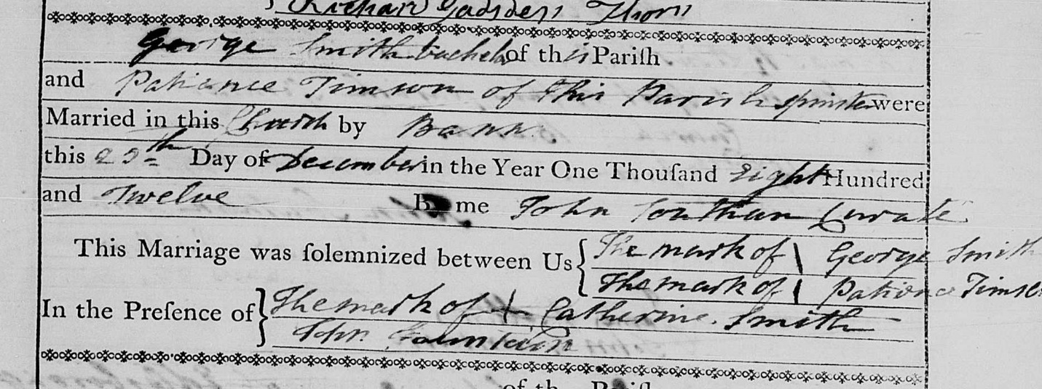
The Marriage Record of George Smith and Patience from the Parish Church in Eaton Bray
What do we learn from this marriage record?
Notes:
1. George and Patience were married on Christmas Day in 1812. Sound romantic or special? They worked 6 days or more per week. 10 hours days or longer. Christmas Day was one day a year the family took off from work.
Neither George nor Patience could write their own name.
George’s sister, Catherine Smith as a witness also could not write.

Slide 6
What was it like to live in Eaton Bray in 1850?
Living conditions
Occupations
Wages
Education
Land and home ownership (there was none)
Notes:
We have seen many photographs of Eaton Bray and it is beautiful. And in 1850 everything belonged to someone else. No private ownership. Everything belonged to the Lord of the Parish.

Slide 7
British Currency in 1850
The British Pound (£)
20 shillings to a pound (£)
240 pence to a pound (£)
A Pound (£) contained 3.3636 troy ounces of pure silver
A US silver $1 coin contained .7736 troy ounces pure silver.
1.00 Pound (£) was worth $4.35 US
1.00 shilling (s) was worth $0.2175 US
1.00 pence (d) was worth $0.018125 US
Many economists agree that $1.00 US in 1850 would be equivalent to approximately $32.41 today accounting for inflation.
Notes:
In order to talk about living conditions we need to understand the British currency and it value in the 1800’s.
Based on silver content one British pound was equal to $4.35 US dollars. While a shilling was worth about 22 cents US! And a Pence was about 2 cents. Is that where “Your two cents worth” comes from?

Slide 8
Some Occupations of our Ancestors
Ag Laborer Many of the adult males were Agricultural laborers
Farmer If they weren’t an Ag Laborer they were listed as a Farmer.
Straw plaiters Most of the children, young women and wives as well as some of the males were Straw-Plaiters
Straw Plait dealer Some of our adult males became Straw Plait Dealers
Blacksmith Many of the Gurneys were Blacksmiths
Sawyer William Wootton was a Sawyer
Bailiff Caleb Smith was a farm Bailiff (Foreman) later in life
Bonnet Sewer Some of the adult women graduated to a Bonnet Sewer
Scholar Later some of the younger children were fortunate enough to go to a formal school. This was mainly after the Education Acts of 1870 and 1880 that required young children to attend school.
Notes:
Father Edward Smith was a Ag laborer all of his life

Slide 9
Straw Plaiting
All of our Smith Ancestors in the 1850s were involved in Straw Plaiting
Eaton Bray, Dunstable, Eldesborough, and Luton was a hot beds of plaiting activity for more than 50 years
Children as young a 3 -4 years of age were engaged in plaiting
Plaiting schools sprang up throughout the area
So what is Straw Plaiting?
Notes:
Since so many of our Smith ancestors were Straw Plaiters I am going to spend some time on this occupation to better understand it.

Slide 10
Straw Plaiting
Plaiting involved gathering or otherwise obtaining straw.
Sorting and selective plait-able sections of straw
Splitting each straw into several thin strips
Flattening each straw section
Braiding these (moist) sections into 20 yard lengths (a score) of usable plait
Taking their scores of plait to market
Notes:
Since so many of our Smith ancestors were Straw Plaiters I am going to spend some time on this occupation to better understand it. There is a large display on what Straw Plaiting is in the Cultural hall.

Slide 11
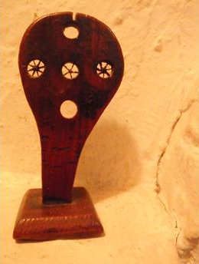
Straw Plaiting Tools
Straw splitter
Notes:
Lengths of straw were pushed or pulled through a straw splitter such as this one. The thickness of the straw would determine how many sections the straw was split into to get uniform pieces of straw to plait.

Slide 12
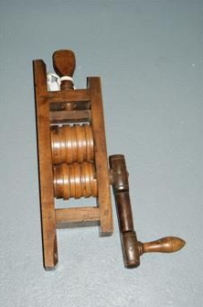
Straw Plaiting Tools
Straw Flattener
Notes:
The sections of split straw were then moistened and flattened using a tool such as this one.

Slide 13
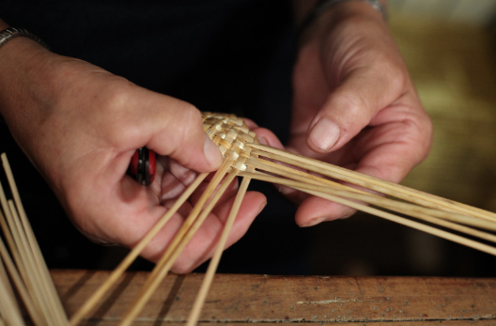
Straw Plaiting
Notes:
This example of plait is weaving 11 pieces of straw into a thick plait possibly an inch wide. They had to keep the straw sections pliable so often they ran the straw through their mouth to keep it moist. I can’t imagine this did not create sores in and around their mouth.

Slide 14
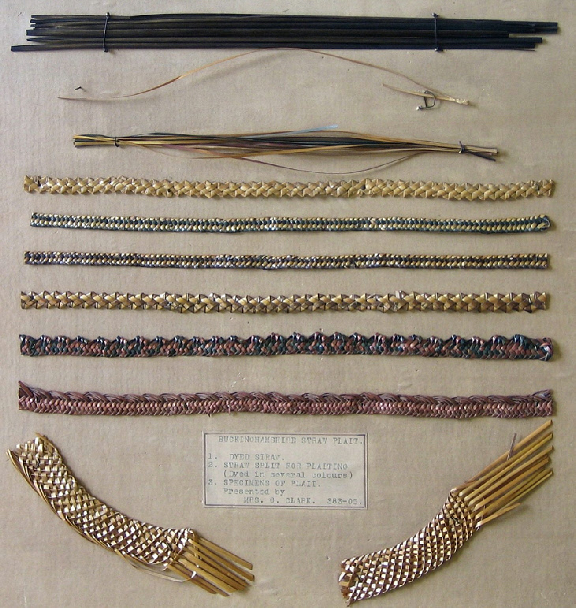
Straw Plaiting Examples
Notes:
Our ancestors most likely created plait like the 4th of 7th example down from the top.

Slide 15
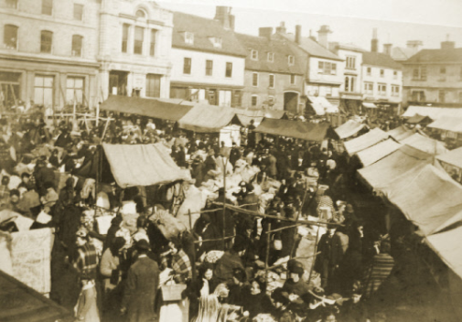
Straw Plait Market in Hitchin near Eaton Bray

Slide 16
The Economics of Straw Plaiting in the1850’s
100 pounds of straw suitable for plaiting cost 3 s And produced
40 pounds of plaitable straw worth 8 – 18 s And produced
17 – 18 pounds of plait worth £7 – 20. And produced
16 – 17 pounds of Straw hats worth £ 23 – 45 wholesale.
Notes:
100 pounds of straw cost 3 shillings or about $0.70 US. Only the bottom two sections of straw was used for plaiting. Thus losing over half the weight of the straw.
40 pounds of plait able straw remained and from that they made 18 pounds of plait worth up to 20 pounds or about $87.00 from which was made 17 pounds of straw hats worth almost $200.00 US.

Slide 17
Earning Potential
One source said a top quality plaiter could get 3s 6d for a score (20 yards) of finished plait and she could possibly make 1 ½ score of plait in a week; Therefore earning 5s 3d in a week.
Another source suggested that a top plaiter could earn as much as 7s per week.
The younger plaiters could add 3d – 6d per day (1 ½ s – 3s per week) to the family income.
A Farmer or Ag Laborer could earn 6s to 7s per week if he worked 10 hours a day and 6 days a week! Which he did!

Slide 18
Straw Plaiting Schools
Children were generally taught the basics of plaiting at home before being sent to a plait school between the ages of three and four when their work was considered to be financially viable. Even younger children could be found in these schools and although unable to plait, children as young as two might be tasked with clipping the loose ends of straws ‘with their scissors tied to their bodies’.
Boys, as well as girls, attended one of the numerous plaiting schools. These schools, found in every town and village in the area, resembled sweat shops rather than places of learning. The misery of the long hours and the rushing discipline of the plait schools is revealed by the Children’s Employment Commission Report of 1864.
“… Mrs. Wimbush, who had a plait school in Northchurch, stated in her evidence that 41 children plaited in a room 10 feet square, and at busy times the same room held 60 children. She also admitted to caning the children. The parents paid 1d. – 3d. a week and supplied the straw. It was rare for any other subject to be taught, as the main function of the mistress was to ensure that the children completed their work…”
Notes:
I believe that our Patience Timson was one of these Plait School Mistresses near the end of her life.

Slide 19
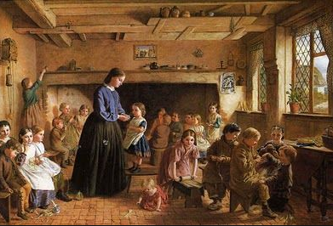
Straw Plaiting Schools
Notes:
This paint of a plaiting school doesn’t resemble at all what we just read.

Slide 20
Cost of Living in 1850 England
What did it cost to live on the English countryside in 1850?
A small family could probably scrape by on £40 or £50 per year.
They would have been much more comfortable living on £70 per year.
The largest expense was probably renting a cottage on the Manor for about £10 per year.
If they could raise some of their own food and make their own clothes so much the better.

Slide 21
How where our Smith’s getting by?
John and Ruth as top quality plaiters could earn 7s each per week in 1851.
Ann, on the other hand, at age 4 could have only added, perhaps, 1s per week.
15s per week total for the family equals 780s per year or £39 per year.
Notes:
John was the fifth child born to George and Patience. He was in between George W and Thomas X. Shown here in the 1851 English census with his wife, Ruth and 4 year old daughter Ann.

Slide 22
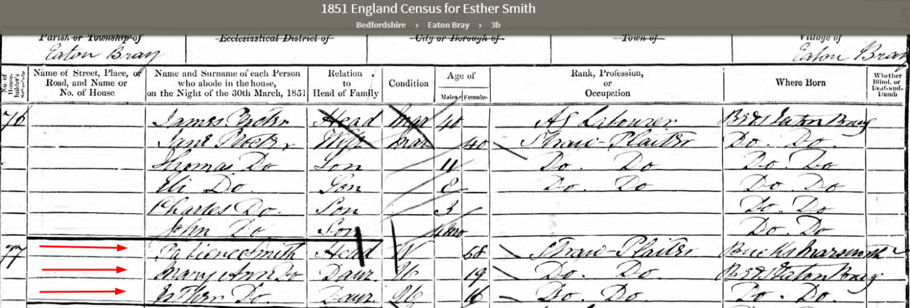
How where our Smith’s getting by?
In 1851 Patience at age 58 is a straw Plaiter as are her two unmarried daughters
Each could have been earning 7s a week
Together they could have made 21s a week or about £55 per year .
In 1861 Patience is still a Plaiter at age 69. Her daughters are bonnet sewers
Notes:
Here is Patience with her two daughter, Mary Ann and Esther in 1851. George has passed away. They are probably doing okay.

Slide 23
What do we know about
The Children of George and Patience
Caleb July 17, 1816 – June 29 1902
Reuben September 6, 1818 - November 7, 1875
James December 31, 1820 – November 1826
George W. May 2, 1823 – June 30, 1888
John November 25, 1825 – May 27, 1884
Thomas X December 25, 1828 – January 1, 1907
Mary Ann 1832 – February 20, 1894
Esther January 10, 1836 – November 11, 1899
Notes:
Let’s now talk about the siblings of Thomas X and George W.

Slide 24
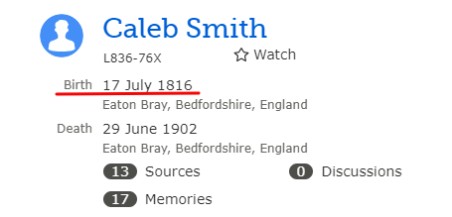
The Siblings of Thomas X and George W. Smith
Caleb was the first born of the children of George and Patience
He lived to be 86 years of age; the longest of all their children
Notes:
Caleb was he the oldest of their Children and lived the longest.

Slide 25
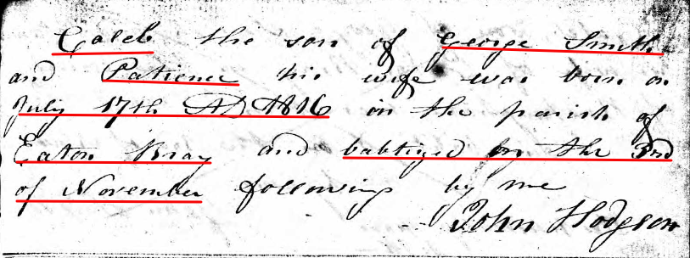
Caleb 1816 - 1902
Caleb was Christened (Baptized) into the Wesleyan Methodist Church at 3 ½ months
Caleb married Mary Calentt on 31 October 1835. He would have been 19 years old. Mary was 20. They had 5 children together
Notes:
Caleb’s parents (George and Patience) were married in the Parrish Church (Church of England) on Christmas Day 1812 yet Caleb is christened in the Wesleyan Methodist Church 3 ½ years later.
Our next insight into Caleb’s life is his marriage to Mary Calentt in 1835.

Slide 26
Caleb 1816 - 1902
Their first child, James, was Christened on October 10, 1836 James died just one year later (cause not yet known)
Their 2nd child, Elizabeth, was born September 4, 1837. Elizabeth married William Hawkins in 1863 and they had
3 children together.
Their third child was a son named George born on March 20, 1844 in Dunstable. He married Elizabeth Barrett and they had 3 children together. He died young at the age of 46.
Their fourth child born June 7, 1847 was also a boy they named Thomas. He married Alice Lovegrove and they had 2 children together. Both of their boys were killed in WWI within one week of each other. Thomas died at age 57.
Notes:
Caleb’s son Thomas had only two children, both boys and each died within a week of each other in April of 1917 in Flanders, France during WWI.

Slide 27
Caleb 1816 - 1902
They had a fifth child who they named Henry born in 1853. He married an Amelia but they had no children.
Caleb’s wife Mary died October 14, 1866 in Edlesborough from Atrophy at age 49.
Caleb married Caroline Culpin on 22 June 1867.
Caleb in the 1871 Census is farming 200 acres with 8 men and 8 boys at the “East End” of Eaton Bray.
In 1881 Caleb now is in Barholm (80 miles from Eaton Bray) and working as a Bailiff on another farm. (He was living here earning 24s per week or 62£ per year ) when Thomas X visits him while on his mission).
Notes:
Atrophy or wasting away. Likely after contracting the Fever.
Thomas went to visit Caleb during his mission in 1880-81. Was received well enough but Caleb still had nothing good to say about the Mormons or the Catholics, for that matter.

Slide 28
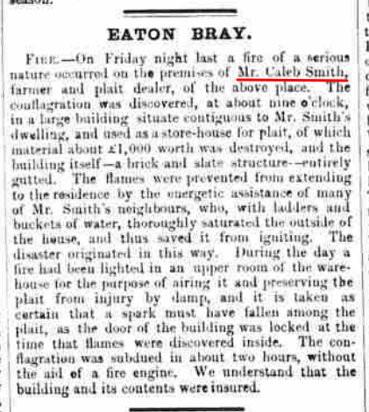
Caleb 1816 - 1902
Article from the Leighton Buzzard Observer November 18, 1873
Notes:
A warehouse next to Caleb’s home containing 1000 £s of straw plait catches fire and is a total loss. The warehouse and plait was insured.

Slide 29
Caleb 1816 - 1902
Caleb is back home in Eaton Bray living on Moor End in 1901 at the age of 84.
Caleb died on June 29, 1902 at the age of 85 years.
He lived and worked farthest away from Eaton Bray than any of the other England dwelling siblings!

Slide 30
Caleb 1816 - 1902
Caleb had a total of 5 children, all from his first wife , Mary
James 1836 -1837
Elizabeth 1837 Married Wm Hawkins and had 3 children
George 1842 Married Elizabeth Barrett and had 3 children
Thomas 1848 Married Alice Lovegrove and had 2 boys who died in WWI
Harry 1853 Married Amelia ? But did not have children
Notes:
Caleb had five children total all from his first wife, Mary Calentt. 4 that lived to adulthood. He had a total of 8 grandchildren but 2 young men died in WWI leaving only 6 grandchildren.

Slide 31
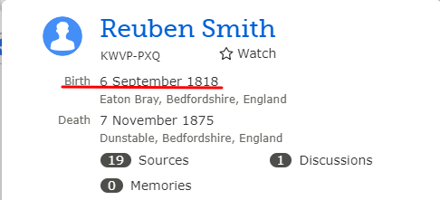
The Siblings of Thomas X and George W. Smith
Reuben is the second born of the children of George and Patience
He died at age 57 having never lived more than 5 miles from his place of birth in Eaton Bray
Notes:
There were Native American Indians living in the area:
The Farmington settlers reportedly had few problems with the local natives. A small tribe of Paiutes lived nearby. Shoshones lived near the mouth of Farmington Canyon. The Indians begged for food, and following the direction of President Young, the settlers gave what they could. Often this was in exchange for beads, blankets and moccasins. These early settlers learned the benefits of moccasins and many pioneer women became quite proficient in making them for their own families.

Slide 32
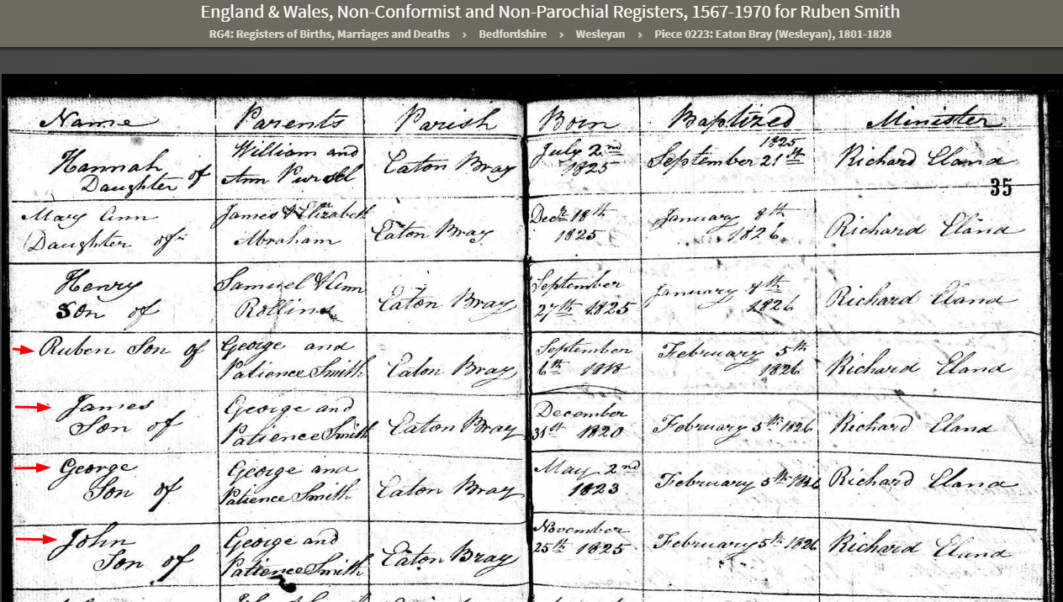
Reuben 1818 - 1875
Reuben was christened on February 6, 1826 along with his three younger brothers: James. George and John in the Wesleyan Methodist Church
Notes:
Reuben was christened in the Methodist Church like his older brother but not until he was age 7. He was christened along with his brothers James, George and John.

Slide 33
Reuben 1818 - 1875
Reuben and Betsy Duncomb were married in Eaton Bray on August 25, 1839. She would have just turned 23 and Reuben was 20 years old.
In 1841 Reuben is living just one house away from his grandparents (George Smith’s father, Edward Smith and his mother, Ann Burrows). Edward is still an Ag Lab at age 77). Edward died in 1947, Ann in 1849.
Their first child, Jabez was born November 18, 1839 but he died just 9 months later.
Betsy died of “Consumption” (Tuberculosis ) on May 20, 1842 after being married for less than 3 years
Notes:
Reuben married Betsy Duncomb on August 25, 1839
In the 1841 Census he was living just one house away from his grandparents, Edward Smith and Deborah (Roe)
They have one child together, Jabez born November 18, 1839 but he died 9 months later.
Betsy also died in 1842 having been married less than three years. She died of Consumption which was highly contagious. Consumption was tuberculosis. It is possible Jabez also died from this contagious disease.

Slide 34
Reuben 1818 - 1875
Reuben married Harriet Cook on 20 November 1843.
By the 1851 Census they have four daughters Ruth (7), Betsy (5), Caroline (3), and Sarah (1)
Ruth was born in 1844 and married William Tripp Fox on October 9, 1877 and they had 4 children. She died April 20, 1924 at the age of 78 years.
Their second daughter, Betsy was born in 1846 and is single in 1881 at age 35 but that is where the trail ran cold.
The third daughter, Caroline, was born on December 27, 1847 in Eaton Bray. She died in December of 1864 at the age of 16.
Notes:
Married to Harriet Cook in 1843 and their first 4 Children were daughters.
1 Ruth married and had 4 children
2 Betsy is missing
3 Caroline is also missing

Slide 35
Reuben 1818 - 1875
The fourth daughter Sarah was born on November 23, 1849 in Eaton Bray. Sarah had a daughter out of wedlock when she was 25 years old. Her name is Maud Smith, born on August 11, 1875. She lived with her Great Aunts, Mary Ann and Esther for years.
Sarah later married Charles Allison at age 34. Sarah died September 29, 1925 having only 1 child.
Notes:
4 Sarah has Maud out of wedlock Later she marries but has no more children

Slide 36
Reuben 1818 - 1875
In 1846 Reuben and his brother, George, are arrested for rioting and assaulting a Police Constable
They are sentenced and serve 30 days hard labor (July 1846)
We get an excellent description of Reuben from his Gaol Record!
Notes:
I did not know that my own great grandfather and his brother were X-Cons.
We haven’t found the cause of the Riot but it is very possible they were protesting working and living conditions as there were reports of such riots.

Slide 37
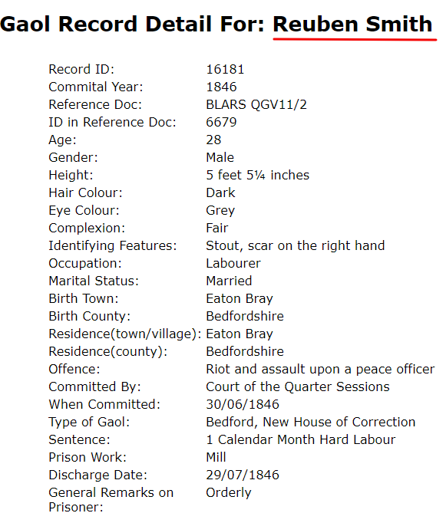
Reuben 1818 - 1875
Notes:
We see from this record that Reuben was 5 51/2 inches tall. Stout with dark hair and grey eyes. He even had a scar on his right hand. And good to know he was an orderly prisoner.

Slide 38
Reuben 1818 - 1875
Reuben and Harriet finally have a son, Job, on November 13, 1851. Unfortunately he died on December 28, 1861 at age 11.
Another daughter, Mary Ann, is born on December 4, 1853. We last see her at age 17, single and living at home.
Another son, George, is born April 4, 1856. He marries Eliza Green and they have 9 children together. George died about 1890.
Reuben’s second wife, Harriet died on March 16, 1859 at home in Dunstable of Typhoid Fever. She was only 41 years old.
Notes:
Job dies at age 11
Mary Ann missing
George Married and had 9 children
Reuben loses his second wife, Harriet to Typhoid Fever

Slide 39
Reuben 1818 - 1875
Reuben married Ann Lambdon on February 6, 1860 in Luton.
Their first child, a son James William is born June 26, 1860. James married an Elizabeth Smith (probably not her maiden name) about 1893 and they had 3 children together.
Their second child, Anne Maria was born June 23, 1862. She married Harry George Powell and they have 2 children.
Their third child, Harriet was born April 7, 1865. Harriet never married and died on January 21, 1945 at the age of 79 years.
A son Thomas was born March 23, 1867 but died two days later on March 25, 1867.
Notes:
Reuben marries for a third time in 1860 to Ann Lambdon
James William married and had 3 children
Anne Maria Married and had 2 children
Harriet never married
Thomas lived only two days

Slide 40
Reuben 1818 - 1875
Charlotte was born July 3, 1868 Dunstable. She married Robert Bruno Kurth on November 23, 1911 at the age of 43. She did not have any children. Charlotte died in September of 1944 at the age of 76 years.
A daughter, Jane was born on January 12, 1871 at home on high Street West in Dunstable. Unfortunately Jane died about two years later on March 21, 1873 of Pneumonia
Their last child, Harry was born on September 13, 1873 in Dunstable. Harry married Florence Annie Kukins in October of 1998 at the age of 25. Florence was 22 years of age. As far as we can tell they had no children. Harry died on April 11, 1956 at the age of 82 years
Notes:
Charlotte married but had no children
Jane died at age 2 of Pneumonia
Harry married but had no children

Slide 41
Reuben 1818 - 1875
Reuben died just two years after his son, Harry was born on November 7, 1875 at the age of just 57 years.
Ann lived another 46 years and died at the age of 86 on April 12, 1921 and was still living at #6 George Street in Dunstable with her unmarried daughter Harriet when she passed away.
Notes:
Reuben died at age 57 om 1875
Ann lived another 46 years and died at age 86

Slide 42
Reuben 1818 - 1875
From Betsy Duncomb we have just 1 Child
Jabez (1839-1840)
From Harriet Cook we have 7 children:
Ruth (1844-1924)
Betsy (1846 -?)
Caroline (1848-1864)
Sarah (1849-1925)
Job (1852-1862)
Mary Ann (1853-?)
George (1856-? after 1910)
Notes:
Let’s recap: From the slide

Slide 43
Reuben 1818 - 1875
From Ann Lambdon we have 7 children:
James William (1860- 1910?)
Annie Maria (1862-after 1911)
Harriett (1865-1945)
Thomas (1867 – 1867)
Charlotte (1868-1944)
Jane (1871-1873)
Harry (1873 – 1856)
Reuben had 15 children in total. Five died before adulthood.
He had a total of 19 grandchildren accounted for.
Notes:
Recap from the slide

Slide 44
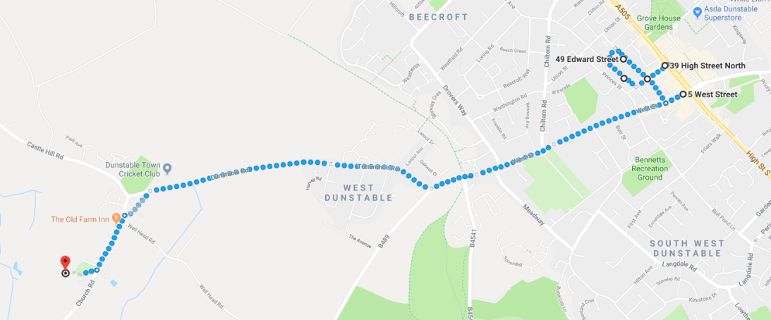
Reuben 1818 - 1875
Reuben never lived more than 5 miles from the place of his birth. Eaton Bray is just 2.5 miles from his dwellings in Dunstable
Notes:
Reuben never lived more that 5 miles from the place of his birth.

Slide 45
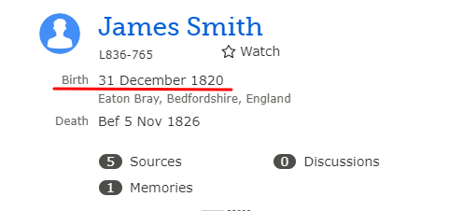
The Siblings of Thomas X and George W. Smith
James was the third child born to George and Patience Smith on 31 December 1820 in Eaton Bray.

Slide 46
James 1820 - 1826
James was christened at age 5 on February 6, 1826 along with his brothers Reuben, George, and John.
James died of unknown causes and was buried on 5 November 1826 at the age of 5 years.
Notes:
We already know that he was christened with three of his other brothers in April of 1826. James died later that same year at the of 5.

Slide 47
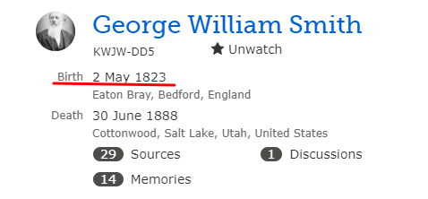
The Siblings of Thomas X and George W. Smith
George was the fourth child and fourth son born to George and Patience Smith on May 2, 1823 in Eaton Bray.
This is a history of his siblings so we'll only add that he was the brother arrested along with Reuben for rioting in 1845.
Notes:
This is a history for the siblings so I will only show his summary page from FamilySearch

Slide 48
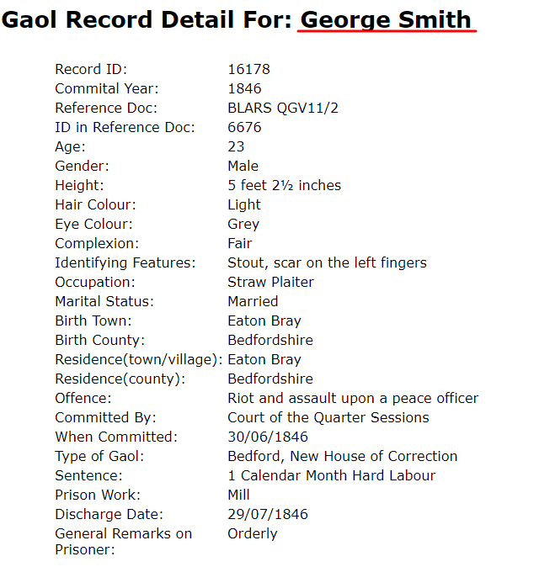
George W. 1823 - 1888
Notes:
George was even shorter than is brother Reuben by 3 inches. Our family never stood a chance for height. George had light hair and was also stout like his brother Reuben.

Slide 49
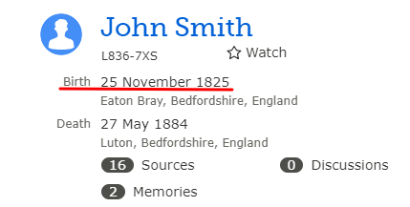
The Siblings of Thomas X and George W. Smith
John was the fifth child born to George and Patience Smith on November 25, 1825 in Eaton Bray.
Notes:
John was the fifth child born to George and Patience Smith

Slide 50
John 1825 - 1884
John was christened at age 2 months on February 5, 1826 along with his brothers Reuben, James, and George.
Notes:
John’s birth appeared to be the catalyst for getting the other three sons christened on February 5, 1826. John was only two months old at the time of his christening.

Slide 51
John 1825 - 1884
John married Ruth Faulkner on Christmas Day in 1843 at Edlesborough, Buckinghamshire.
Their first child a girl they named Ann. She was born on July 24, 1846 in Eaton Bray. She was shown in the 1851 Census as a Straw Plaiter at the age of 4! Ann married Peter Champkin in 1865 and they had 10 children. These children were all sealed to their parents yesterday!
Their second child, Martha, was born on October 15, 1848 in Eaton Bray. We last see her as a 22 year old single woman living as a “boarder” in Luton.
Their third child is also a girl named Hannah. She was born in December of 1849 or January of 1850. She, too, is missing after age 20.
Notes:
John married Ruth Faulkner on December 25, 1843.
Another Christmas day Marriage. Remember what I said about getting married on Christmas Day.
1. Their daughter. Ann is listed as a straw plaiter at the age of 4 in the 1851 Census. We saw that example earlier. Ann married and had 10 Children. All were sealed to their parents yesterday
Second daughter Martha is missing after age 22.
Third daughter Hannah is also missing at age 20. It is more difficult finding daughters than sons because of their maiden name gets lost after marriage. Common names like Hannah and Martha doesn’t help.

Slide 52
John 1825 - 1884
A fourth daughter, Sarah, was born May 30, 1853 in Eaton Bray. Unfortunately she died just short of her second birthday on March 22, 1855 of Whooping Cough.
John and Ruth finally have a son, named, Thomas born in Dunstable on January 22, 1856. He married Jane Fenson and they had 3 children.
Their sixth child was also a boy named Frederick born on December 20, 1859 on Beale Street, Houghton Regis. He died of Scarlet Fever on November 22, 1863 just short of his fourth birthday.
Emily, there seventh child was born at 5 pm on July 13, 1861 on Ashton Street in Dunstable. She also died of Scarlet fever two days before her brother Frederick on November 20, 1863.
Notes:
4, A fourth daughter, Sarah is born in 1853 but she died less than two years later of Whooping cough.
Finally a son is born, Thomas is born in 1856. He married and had 3 children
Another son is born in 1859 and named Frederick. He died just short of his 4th birthday of Scarlet Fever.
Emily, their 7th child is born in 1861 and she, too died from Scarlett Fever just 2 days before her brother Frederick.
So Sarah (at 22 months) dies of Whooping cough in 1855 and Emily (at 30 months) dies of Scarlett Fever on Nov 21, 1863 and two days later their son, Frederick (age 3) dies of Scarlett fever.
3 of their first 7children are gone!

Slide 53
John 1825 - 1884
An eight child, Sarah, was born on May 23, 1863 at Mount Street in Dunstable. No doubt she was named after their Sarah who died in 1855. She married Walter Edward Whitby. They had three children, the last of which died in 1976.
Their last child, Arthur William was born April 16, 1866 at their home on High Street in Dunstable. Unfortunately, he too, died just short of his second birthday on March 17, 1868.
John died on May 27, 1884 in Luton. His wife, Ruth, was present at his death. He was only 58 years old.
Ruth passed away on December 14, 1911 at the age of 88 .
Notes:
Their 8th child they also name Sarah, no doubt in honor of their Sarah who died . She lived to adulthood married and had 3 children
Their 9th and last child named Arthur William was born in 1866 but, he too, died just short of his 2nd birthday.
John died in 1884 at the age of 58 years. Ruth lived to be 88 years old

Slide 54
John 1825 - 1884
Children of John Smith and Ruth Faulkner
Ann born 1846 married Peter Champkin and had 10 children
Martha born 1848 missing after 1871 Census
Hannah born 1850 missing after 1881 Census
Sarah born 1853 died at age 22 months
Thomas born 1856 married Jane Fensom and had 3 children
Frederick born 1859 died at age 3
Emily born 1861 died at age 2
Sarah born 1861 married Walter E. Whitby and had 3 children
Arthur William born 1866 died at age 23 months
4 of their 9 children died before the age of 4 years
2 daughters are unaccounted for as young adults
John and Ruth had 16 grandchildren that we have accounted for.
Notes:
To summarize, John and Ruth had 9 children.
4 of their 9 died before the age of 4 years.
2 daughters, Martha and Hannah are unaccounted for as young adults
Three children gave them 16 grandchildren

Slide 55
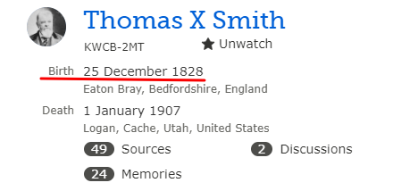
The Siblings of Thomas X and George W. Smith
Thomas X was the sixth child born to George and Patience
on Christmas Day in 1828.

Slide 56
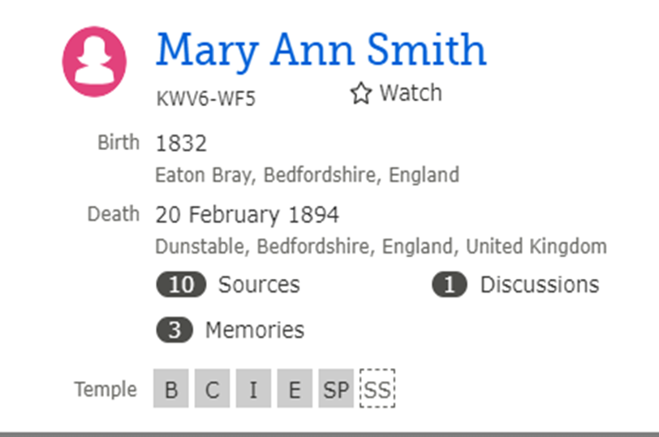
The Siblings of Thomas X and George W. Smith
Mary Ann was the seventh child born to George and Patience in 1832. We have yet to find an actual record of her birth.
Notes:
Finally after six boys George and Patience finally have a girl, Mary Ann born in 1832

Slide 57
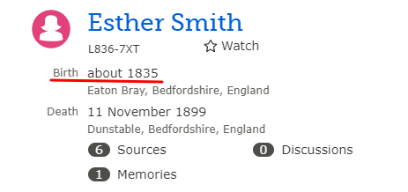
The Siblings of Thomas X and George W. Smith
Esther was the eighth child born to George and Patience in 1835 in Eaton Bray. We have yet to find an actual record of her birth.
Notes:
Their last child is also a girl they name Esther. She is born in 1835.
For some reason we have not been able to find the birth records for either girl. Their birth year is calculated from Census records.

Slide 58
Mary Ann 1832 – 1894
Esther 1836 - 1899
Mary Ann (9) and Esther (6) first appear in the 1841 Census living with their parents in Eaton Bray.
In 1851 Mary Ann (19) and Esther (16) are living with their widowed mother in Eaton Bray. George died in 1844 at the age of 52. Both are single and straw plaiters like their mother.
In 1861 Mary Ann (29) and Esther (26) are single, living with their mother who is still a Plaiter at the age of 67. The girls have become Bonnet Sewers. They have moved to Dunstable.
In 1871 Mary Ann (39) and Esther (36) are single, living with their mother, Patience, who, at age 77, is listed as a “School Mistress”.
Notes:
We will talk about these two sisters together since they appear to have spent their entire lives together.
I showed then earlier in the 1851 Census. In 1861 we note that Patience was still a straw plaiter at age 67. Her two daughters are unmarried and having been plaiters all their lives are now Bonnet Sewers.
It is not until age 77 (in the 1871 Census) that Patience is listed as a school mistress. Almost certainly she taught plaiting at one of the many plaiting schools in the area.

Slide 59
Mary Ann 1832 – 1894
Esther 1836 - 1899
In 1881 Mary Ann (49) is listed as head of household living with her sister Esther (46) and niece Maud (5). Both are single and still Bonnet Sewers.
Maud is the daughter of Sarah, who is the daughter of Reuben
Their mother, Patience, died in 1972 at the age of 79.
In 1891 Mary Ann is (59) Single, Bonnet Sewer. Esther is 56 and a Bonnet Sewer. Maude, age 15 is a dress maker
Mary Ann died of Cardio Failure at age 62 in 1892
Esther died of Liver Cancer at age 65 in 1899
Mary Ann and her sister, Esther never lived more than 5 miles from the place of their birth. Nor did Patience for that matter.
Notes:
In 1881 Mary Ann (49) has become the head of house.
Esther is 46
Maud, who is Sarah’s daughter, who is the daughter of Reuben is living with their Great Aunts at age 5
Patience passed away in 1972 at the age of 79 having Plaited Straw almost her entire life.
In the 1991 Census Mary Ann, now 59, and Esther, age 56 are still single and still bonnet Sewers. Maude is a 15 year old dress maker.
Mary Ann dies at age 62 of heart failure and her sister, Esther dies of Liver Cancer at age 65. Neither having married or lived more than 5 miles from where they were born and worked their entire lives as plaiters and bonnet sewers.

Slide 60
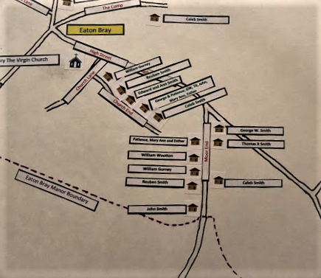
The Siblings of Thomas X and George W. Smith
Where are Smiths lived in 1841 and 1851
Notes:
I was compelled, Kim might say “Driven”, to find where each sibling lived at the various Census dates.
In 1841 the entire family is living in homes (Cottages) on Church End Street probably within 600 feet of one another.
In 1851 they have all moved to Moor End Street and again are living within probably ½ mile of one another (Even though there was supposed to be bad feelings toward those that joined the Church)
I have a larger display set up in the other room which shows what I found out.

Slide 61
The Siblings of Thomas X and George W. Smith
Concluding Remarks
Our 1850’s Smiths were hard working and industrious, yet poor people
They had little or no formal schooling
Most could not read or write except what was self taught
They had love and concern for one another and wanted to be together
What a different live Thomas X and George W. had by coming to America
Notes:
Concluding Remarks
Our 1850’s Smiths were hard working and industrious, yet poor people
They had little or no formal schooling
Most could not read or write except what was self taught
They had love and concern for one another and wanted to be together
What a different live Thomas X and George W. had by coming to America
How grateful I am for the sacrifice Thomas and George made in the name of their new found religion

